Slide 1
Part 1: Information Retrieval

Slide 2
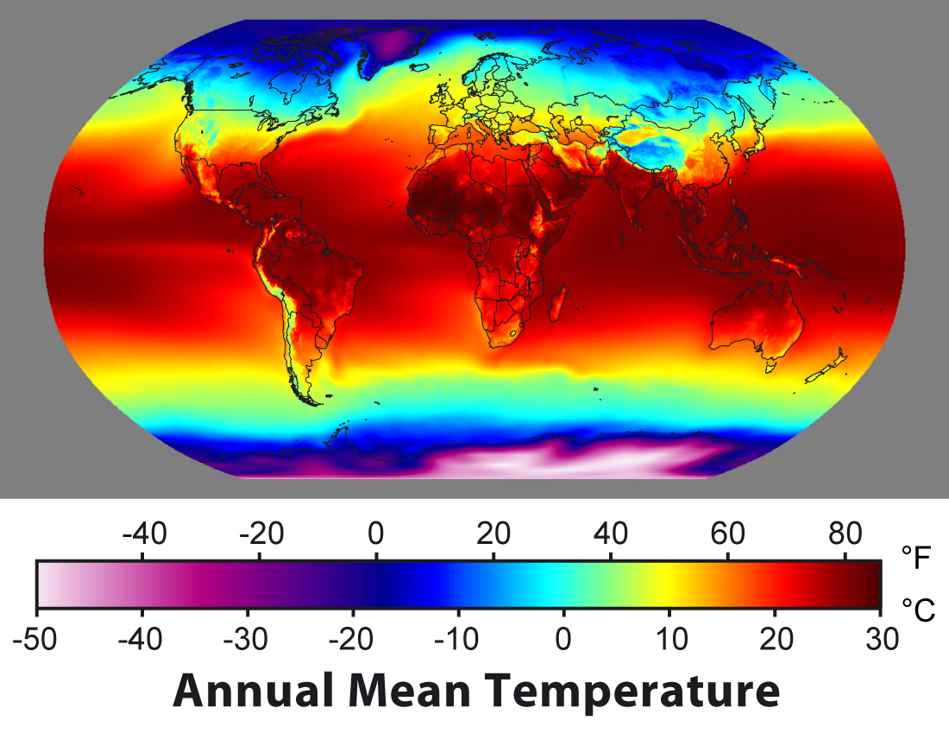

Information Management Tasks
model M
Retrieval: given a model, find some specific data
Data mining: given data, find a model the matches the data
data
Notes:
Since the central role of an information system is to support a model of a real-world phenomen based on data, the key information management tasks are related to the interplay between data and models. We can identify two directions for this interplay: from models to data, and from data to models. From models to data is commonly what we understand by retrieval, or information retrieval.
Given a model, we would like to learn about specific aspects of reality. If we have a model of the temperature distribution in the world, we would like to retrieve the temperature at a specific location or the global average temperature. For Web search we would use a model of how search terms provided by user to a Web search engine relate to documents considered as being relevant by the user, to retrieve the results of a user query.
Going from data to models is what is commonly called data mining. Often we find big data collections for which we do not have a proper or only incomplete interpretation. For example, we might have temperature measurements at given points, but do not understand the correlations among those measurements or the values at locations without measurements. If we have large document collections, we do not understand which are the topics that are covered by those documents. Data mining deals with the problem of providing algorithms that reveal hidden structures in data in order to create new models. Both information retrieval and data mining will be central topics that will be covered in this course.

Slide 3
Overview
Information Retrieval
Text-Based Information Retrieval
Vector Space Retrieval
Evaluating Information Retrieval
Inverted Index
Distributed Retrieval
Query Expansion
Probabilistic Information Retrieval
Latent Semantic Indexing
Word Embeddings
Link-Based Ranking

Slide 4
1. Information Retrieval

Slide 5
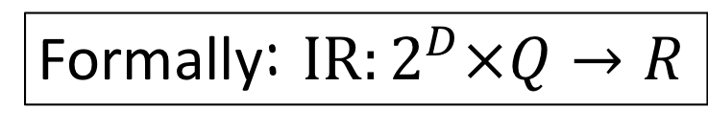
What is Information Retrieval?
Information retrieval (IR) is the task of finding in a large collection of documents those that satisfy the information needs of a user
Examples
Searching documents in a library
Searching the Web
Formally: $IR:2^{D}×Q→R$
Notes:
Information retrieval deals with the problem of matching information needs of human users with information provided in large document collections. Important aspects of this definition are:
Documents are largely unstructured data; documents can be based on different media, including text, images, videos
Document collections are generally large, with the Web being a prime example of a very large document collection
Information needs are user-driven; there exists no formal (mathematical) definition of the information retrieval task

Slide 6
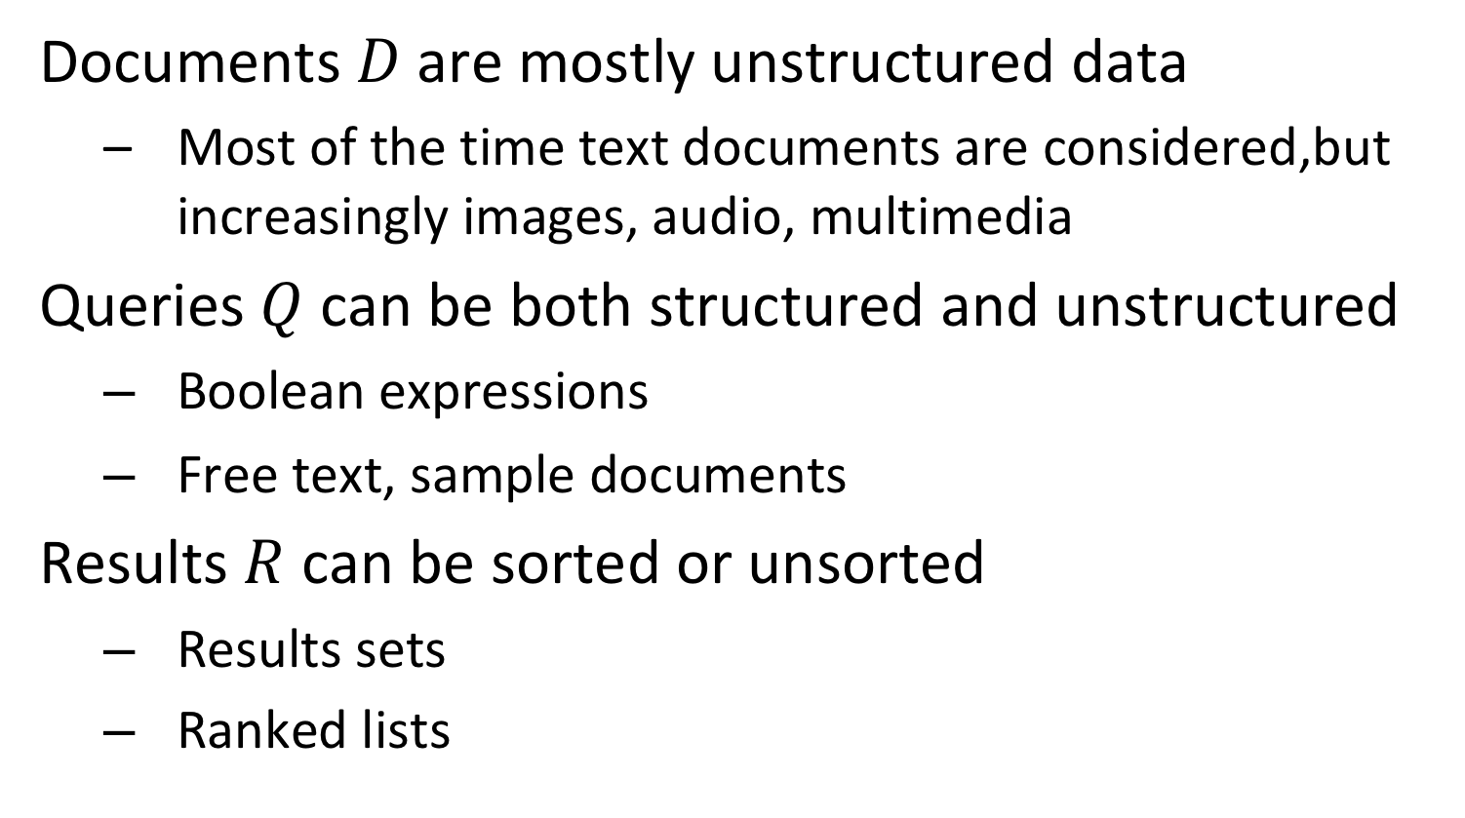
Different Types of Information Retrieval
Documents $D$are mostly unstructured data
Most of the time text documents are considered,but increasingly images, audio, multimedia
Queries $Q$ can be both structured and unstructured
Boolean expressions
Free text, sample documents
Results $R$ can be sorted or unsorted
Results sets
Ranked lists

Slide 7
Basic Information Retrieval Approach
information items (unstructured) content
retrieval system: efficiency
feature extraction
retrieval model: relevance
structured document representation
ranked/ binary
result
similarity ?
structured query representation
matching
query formulation
information need
(unstructured) query
Notes:
An information retrieval system has to deal with the following tasks:
Generating structured representations of information items: this process is called feature extraction and can include simple tasks, such as extracting words from a text as well as complex methods, e.g., for image or video analysis.
Generating structured representations of information needs: often this task is solved by providing users with a query language and leave the formulation of structured queries to them. This is the case, for example, for simple keyword based query languages, as used in Web search engines. Some information retrieval systems also support the user in the query formulation, e.g., through visual interfaces.
Matching of information needs with information items: this is the algorithmic task of computing similarity of information items and retrieval queries. The heart of this step is the information retrieval model. Similarity measures on the structured representations of queries and documents are used to model relevance of information for users. As a result, a selection of relevant information items or a ranked result can be presented to the user.
Since information retrieval systems deal usually with large information collections and/or large user communities, the efficiency of an information retrieval system is crucial. This imposes fundamental constraints on the retrieval model. Retrieval models that would capture relevance very well, but are computationally prohibitively expensive, are not suitable for an information retrieval system.

Slide 8
Example: Text Retrieval
Web documents text content
information retrieval system: Google,
Bing etc.
feature extraction:
terms, words
retrieval model: Boolean, Vector etc.
example: "web retrieval"
ranked list of Web documents
similarity ?
example:
"web information retrieval"
matching: occurrence of
query terms in
document
query formulation:
keywords
Web search
Notes:
The most popular information retrieval system are Web search engines. To a large degree, they are text retrieval systems, since they exploit mainly the textual content of Web documents for retrieval. However, current Web search engines also exploit link information and even image information. The three tasks of a Web search engine for retrieval are:
extracting the textual features, which are the words or terms that occur in the documents. We assume that the web search engine has already collected the documents from the Web using a Web crawler.
support the formulation of textual queries. This is usually done by allowing the entry of keywords through Web forms.
computing the similarity of documents with the query and producing from that a ranked result. Here Web search engines use standard text retrieval methods, such as Boolean retrieval and vector space retrieval. We will introduce these methods in detail in this lecture later.

Slide 9
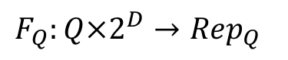
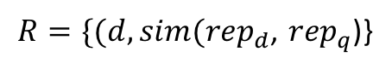
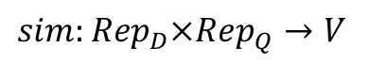
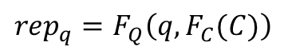

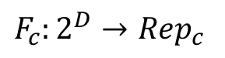

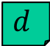
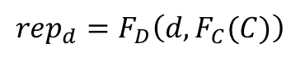
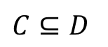
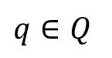
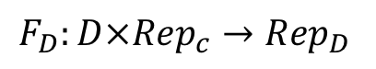
How is the function $IR:2^{D}×Q→R$ computed?
$$C⊆D$$
$$F_{c}:2^{D}→{Rep}_{c}$$
The representation depends on the individual document as well as on the features of collection $C$!
$$F_{D}:D×{Rep}_{c}→{Rep}_{D}$$
$$d$$
$${{rep}_{d}=F}_{D}\left(d,F_{C}(C)\right)$$
$R=\{(d,sim({rep}_{d}$, ${rep}_{q}$)}
$$sim:{{Rep}_{D}×Rep}_{Q}→V$$
$${{rep}_{q}=F}_{Q}\left(q,F_{C}(C)\right)$$
$$F_{Q}:Q×2^{D}→{Rep}_{Q}$$
The similarity function can be computed
for each document individually!
$$q∈Q$$
Notes:
Here we provide a more formal description of how information retrieval models work in general. They rely on feature extraction functions $F_{c}$, $F_{D}$ and $F_{Q}$ that produce a representation for each document and query, as well as features that are related to the collection as a whole ($F_{C}(C)$). With such representations it becomes in particular possible to compute similarity between a document and query for each document individually, based on their representations. The collection features need to be extracted only once and stay the same for all similarity computations. This reduces overall the complexity of the similarity computation.

Slide 10
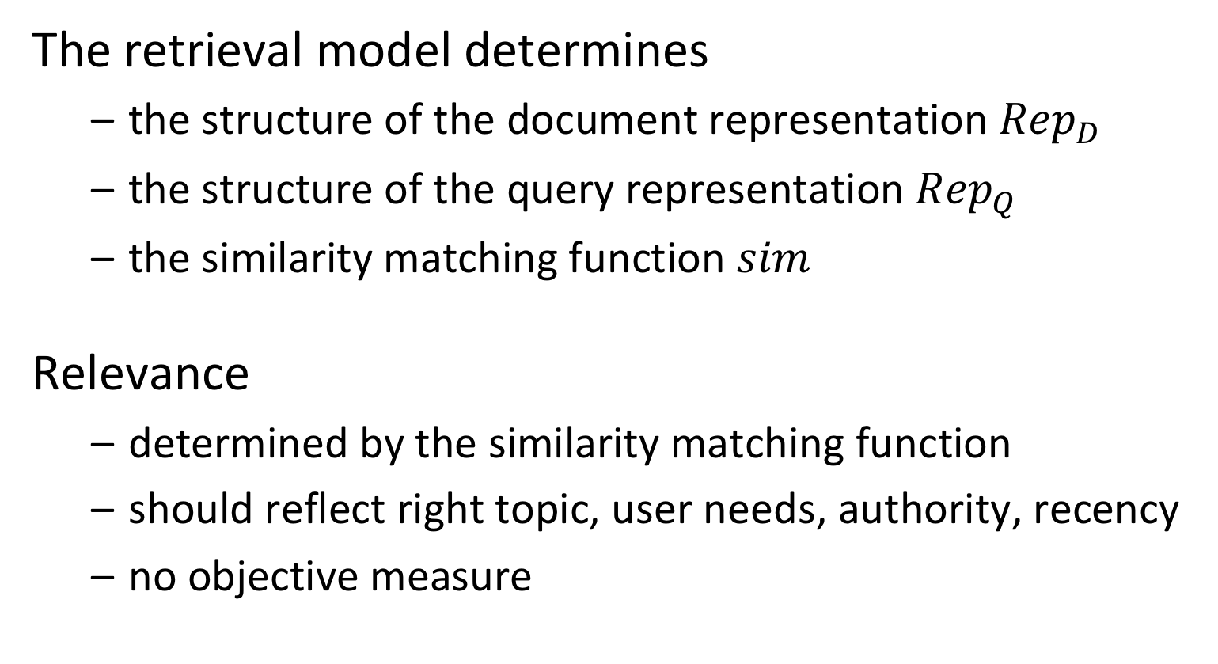
Retrieval Model
The retrieval model determines
the structure of the document representation ${Rep}_{D}$
the structure of the query representation ${Rep}_{Q}$
the similarity matching function $sim$
Relevance
determined by the similarity matching function
should reflect right topic, user needs, authority, recency
no objective measure
Notes:
The heart of an information retrieval system is its retrieval model. The retrieval model is used to capture the meaning of documents and queries, and determine from that the relevance of documents with respect to queries. Although there exist a number of intuitive notions of what determines relevance one must keep clearly in mind that it is not an objective measure.

Slide 11
What are the Features of a Document?
Content
Social
Concept
People can be
Authors of documents
Consumers of documents
Mentioned within the documents
Explicitly annotated or automatically extracted
Content consists of the text, and possibly other media, such as images, videos
Concepts are general ideas mentioned, they can be
Explicitly annotated, e.g., hashtags, keywords
Automatically extracted, e.g., entities, concepts
Notes:
In general, there are three types of features that can be associated with a document:
The document content: depending on the media this is the characters of text, the pixels of an image, the images of a video. In information retrieval features extracted of the content are the main source of input for retrieval methods to create structured representations of the documents. It is important to note that these structured representations are only used internally to the retrieval system and not visible to the human user. We will first strongly focus on content-based information retrieval for text documents.
The authors of the document: documents are authored, referenced and consumed by people. This social context can provide very useful to enhance the performance of information retrieval algorithms
The concepts mentioned in document: concepts are general ideas that have a specific meaning to humans and thus are – different to content features – visible to human users. They can be either manually annotated or automatically extracted, and also help in the retrieval task. Since they are human-understandable, they can be in fact explicitly used in order to perform structured searches for documents. We will see in the last part of the lecture (extracting knowledge from documents) how automated methods can extract concepts from documents.

Slide 12
Relationships!
People interact among each other through documents: SOCIAL NETWORKS / COMMUNITIES / INFLUENCE
Documents share similar content: SEARCH / CLUSTERING / TOPICS / CLASSIFICATION
Concepts have relationships:
TAXONOMIES / ONTOLOGIES
Notes:
Each type of the aforementioned features is used to create relationships:
Content-based features are used to compute document similarity, one of the basic approaches in information retrieval, this part of the lecture. Document similarity allows to search, cluster or classify documents
Social features are used to create social networks, which can then be analyzed for influence (used in information retrieval) or communities (we will see in the lecture part on data mining how to extract communities)
Concept features can be organized through semantic relationships in taxonomies and ontologies, which allow to classify and search documents (we will see in the lecture part on knowledge extraction how to infer such relationships)

Slide 13
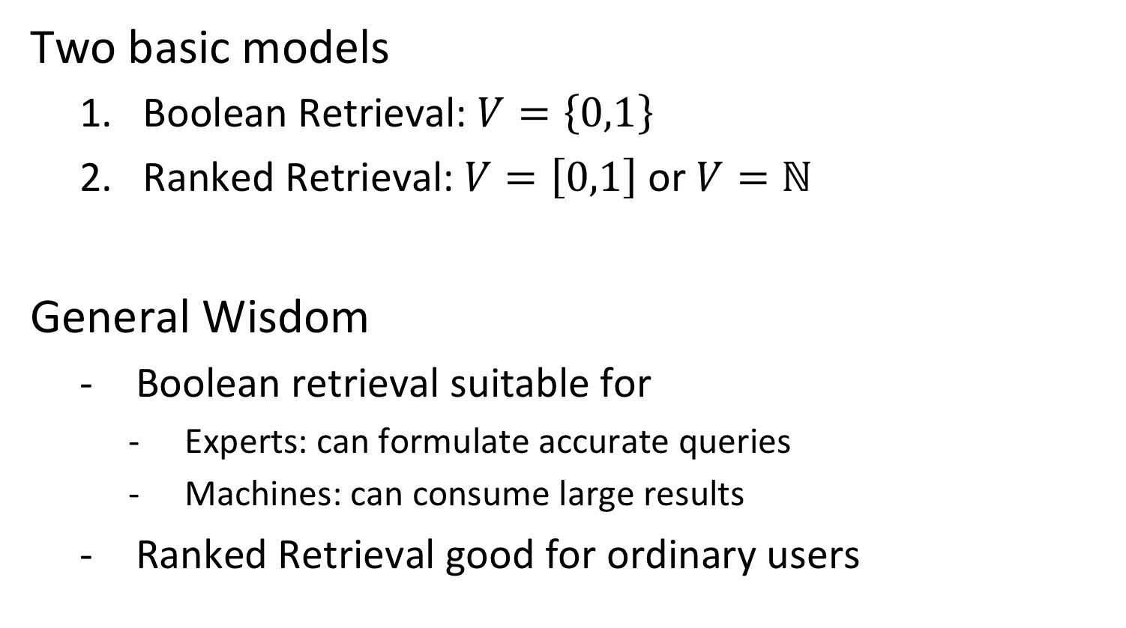
What does the Similarity Function compute?
Two basic models
Boolean Retrieval: $V=\left\{0,1\right\}$
Ranked Retrieval: $V=\left[0,1\right]$ or $V=ℕ$
General Wisdom
Boolean retrieval suitable for
Experts: can formulate accurate queries
Machines: can consume large results
Ranked Retrieval good for ordinary users
Notes:
There exist two basic models of what information retrieval produce as results. In Boolean retrieval the system returns a set of results. The main issue with this approach is that it is in general very difficult to formulate a query that produces a reasonably sized result set, that is not too large and not too small or empty. This is called sometimes the “feast of famine” problem. In contract, ranked retrieval allows to to produce a list of result that is sorted by relevance. We may distinguish further whether scores are returned ($V=\left[0,1\right])$ which allows to assess the relative relevance of different results based on the scores, or whether simply a ranked list is returned ($V=ℕ$). The most common models return score values.

Slide 14
Information Filtering
filtering system: efficiency
retrieval model: relevance
information item content
feature extraction
structured document representation
similarity ?
disseminate item if relevant
structured query representation
matching
query profile
information
needs
Notes:
The roles of documents and queries can be swapped in an information retrieval system. As a result one obtains an information filtering system. Information filtering systems can be based on the same retrieval models as standard information retrieval systems for ad-hoc query access.

Slide 15
Information Retrieval and Browsing
Retrieval
Produce a ranked result from a user request
Interpretation of the information by the system
Browsing
Let the user navigate in the information set
Relevance feedback by the human
Retrieval
?
Browsing
Notes:
Information retrieval is usually closely connected to the task of browsing. Browsing is the explorative access by users to large document collections. By browsing a user implicitly specifies his/her information needs through selection of documents. This feedback can be used by an information retrieval system in order to improve its query representation and thus the retrieval result. One example of such an approach we will see when introducing relevance feedback. On the other hand, results returned by information retrieval systems are usually large, and therefore browsing is needed by users in order to explore the results. Both activities, retrieval and browsing thus can be combined into an iterative process.

Slide 16
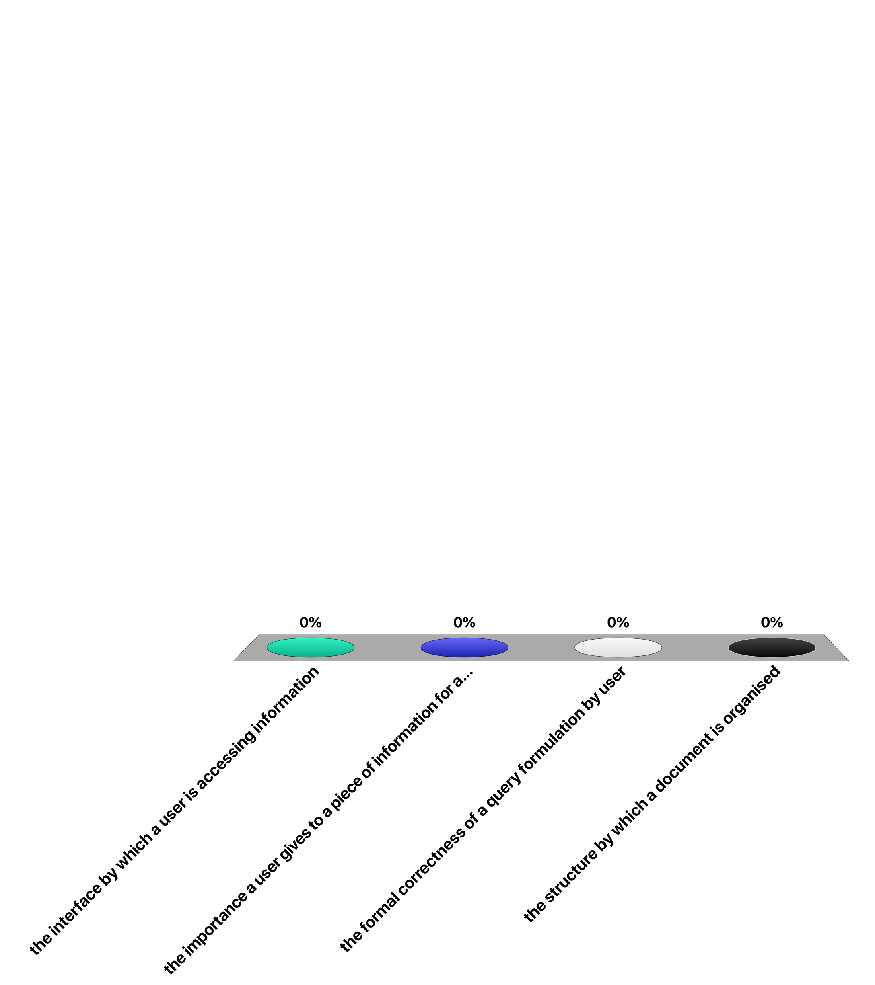
A retrieval model attempts to capture …
the interface by which a user is accessing information
the importance a user gives to a piece of information for a query
the formal correctness of a query formulation by user
the structure by which a document is organised

Slide 17
2. Text-based Information Retrieval

Slide 18
Text-based Information Retrieval
Most of the information needs and content are expressed in natural language
Library and document management systems
Web Search Engines
Basic approach: use the words that occur in a text as features for the interpretation of the content
This is called the "full text” or “bag of words” retrieval approach
Ignore grammar, meaning etc.
Simplification that has proven successful
Document structure, layout and metadata may be taken into account additionally (e.g. PageRank/Google)
Notes:
Traditional information retrieval has been primarily concerned over many years with the problem of retrieving information from large bodies of documents with mostly textual content, as they where typically found in library and document management systems. The problems addressed were classification and categorization of documents, systems and languages for retrieval, user interfaces and visualization. The area was perceived as being one of narrow interest for a highly specialized user community, mainly librarians. The advent of the WWW changed this perception completely, as the web is a universal repository of documents with universal access.
Since nowadays most of the information content is still available in textual form, text is an important basis for information retrieval. Natural language text carries a lot of meaning, which still cannot fully be captured computationally. The research in cognitive science, especially linguistics suggests that perhaps this can never be done. Therefore information retrieval systems are based on strongly simplified models of text, ignoring most of the grammatical structure of text and reducing texts essentially to the terms they contain. This approach is called full text retrieval and is a simplification that has proven to be very successful. Nowadays, this approach is gradually extended by taking into account other features of documents, such as the document or link structure.

Slide 19
Architecture of Text Retrieval Systems
User
Interface
Text
user need
Text
1. feature extraction
Text Operations
query repr.
document repr.
Query
Operations
DB Manager
Module
Indexing
user feedback
query
inverted file
Searching
Index
retrieved docs
3. efficient data access
Text
Database
Ranking
ranked docs
2. ranking system
Notes:
This figure illustrates the basic architecture with the different functional components of a text retrieval system. We can distinguish three main groups of components:
the feature extraction component: it performs text processing to turn queries and text documents into a keyword-based representation
the ranking system: it implements the retrieval model. In a first step user queries are potentially modified (in particular if user relevance feedback is used), then the documents required for producing the result are retrieved from the database and finally the similarity values are computed according to the retrieval model in order to compute the ranked result.
the data access system: it supports the ranking system by efficiently retrieving documents containing specific keywords from large document collections. The standard technique to implement this component is called inverted files.
In addition we recognize two components to interface the system to the user on the one hand, and to the data collection on the other hand.

Slide 20
Pre-Processing Text for Text Retrieval
Feature Extraction
Tokens
Manual
indexing
Docs
stopwords
stemming
Structure
Layout
Metadata
Structured
data
Full text
Index terms
Notes:
In full text retrieval each document is represented by a set of representative keywords or index terms. Using index terms is an ancient concept that has been used in books. The earliest example of an index is from a temple library in Babylon, cataloging the subjects of the cuneiforms. An index term is a document word useful for capturing the document's main topics. Often, index terms are only nouns, because nouns carry meaning by themselves, whereas verbs express relationships between words. These relationships are more difficult to extract.
When using words as text features normally a stepwise processing approach is taken: in a first step, the document structure, e.g., from XML, is extracted and if required stored for further processing. The remaining text is stripped of special characters, producing the full text of the document as a sequence of tokens. Then very frequent words which are not useful for retrieval, so-called "stopwords", are eliminated (e.g. "a", "and" etc.). As the same word can occur in natural language in different forms, usually stemming is used: Stemming eliminates grammatical variations of the same word by reducing it to a word root, e.g., the words connecting, connection, connections would be reduced to the same "stem" connect. This step can be followed by a manual intervention, where humans can select or add index terms based on their understanding of the semantics of the document. The result of the process is a set of index terms which represents the document.

Slide 21
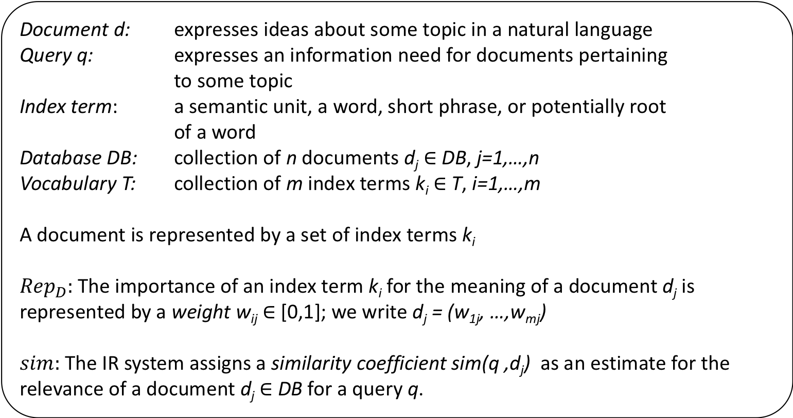
Text Retrieval - Basic Concepts and Notations
Document d: expresses ideas about some topic in a natural language
Query q: expresses an information need for documents pertaining to some topic
Index term: a semantic unit, a word, short phrase, or potentially root of a word
Database DB: collection of n documents d_{j} $∈$ DB, j=1,…,n
Vocabulary T: collection of m index terms k_{i} $∈$ T, i=1,…,m
A document is represented by a set of index terms k_{i}
${Rep}_{D}:$The importance of an index term k_{i} for the meaning of a document d_{j} is represented by a weight w_{ij} $∈$ [0,1]; we write d_{j} = (w_{1j}, …,w_{mj})
$sim:$The IR system assigns a similarity coefficient sim(q ,d_{j}) as an estimate for the relevance of a document d_{j} $∈$ DB for a query q.
Notes:
We introduce the precise terminology we will use in the following for text retrieval systems. Note that the way of how specific weights are assigned to an index term with respect to a document and of how similarity coefficients are computed are part of the definition of the text retrieval model.

Slide 22
Example: Documents
B1 A Course on Integral Equations
B2 Attractors for Semigroups and Evolution Equations
B3 Automatic Differentiation of Algorithms: Theory, Implementation, and Application
B4 Geometrical Aspects of Partial Differential Equations
B5 Ideals, Varieties, and Algorithms: An Introduction to Computational Algebraic Geometry and Commutative Algebra
B6 Introduction to Hamiltonian Dynamical Systems and the N-Body Problem
B7 Knapsack Problems: Algorithms and Computer Implementations
B8 Methods of Solving Singular Systems of Ordinary Differential Equations
B9 Nonlinear Systems
B10 Ordinary Differential Equations
B11 Oscillation Theory for Neutral Differential Equations with Delay
B12 Oscillation Theory of Delay Differential Equations
B13 Pseudodifferential Operators and Nonlinear Partial Differential Equations
B14 Sinc Methods for Quadrature and Differential Equations
B15 Stability of Stochastic Differential Equations with Respect to Semi-Martingales
B16 The Boundary Integral Approach to Static and Dynamic Contact Problems
B17 The Double Mellin-Barnes Type Integrals and Their Applications to Convolution Theory
Notes:
This is an example of a (simple) document collection that we will use in the following as running example.

Slide 23
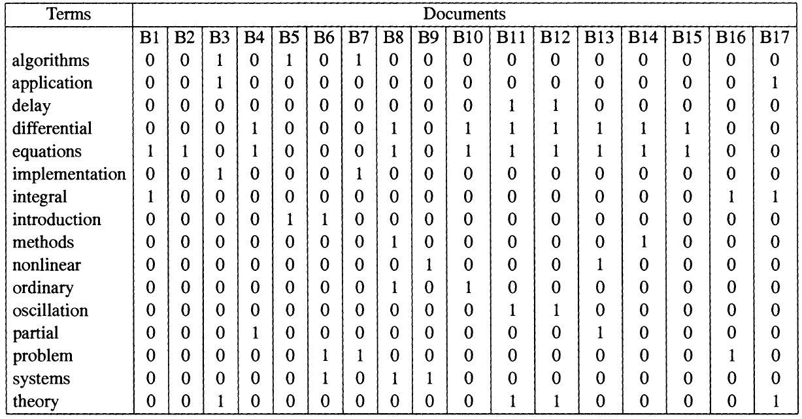
Term-Document Matrix
Matrix of weights w_{ij}
This example
Vocabulary (contains only terms that occur multiple times, no stop words)
all weights are set to 1 (equal importance)
Notes:
In text retrieval we represent the relationship between the index terms and the documents in a term-document matrix. In this example only a selected vocabulary is used for retrieval, consisting of all index terms that occur in more than one document and only weights of 1 are assigned, indicating that the term occurs in the document.

Slide 24
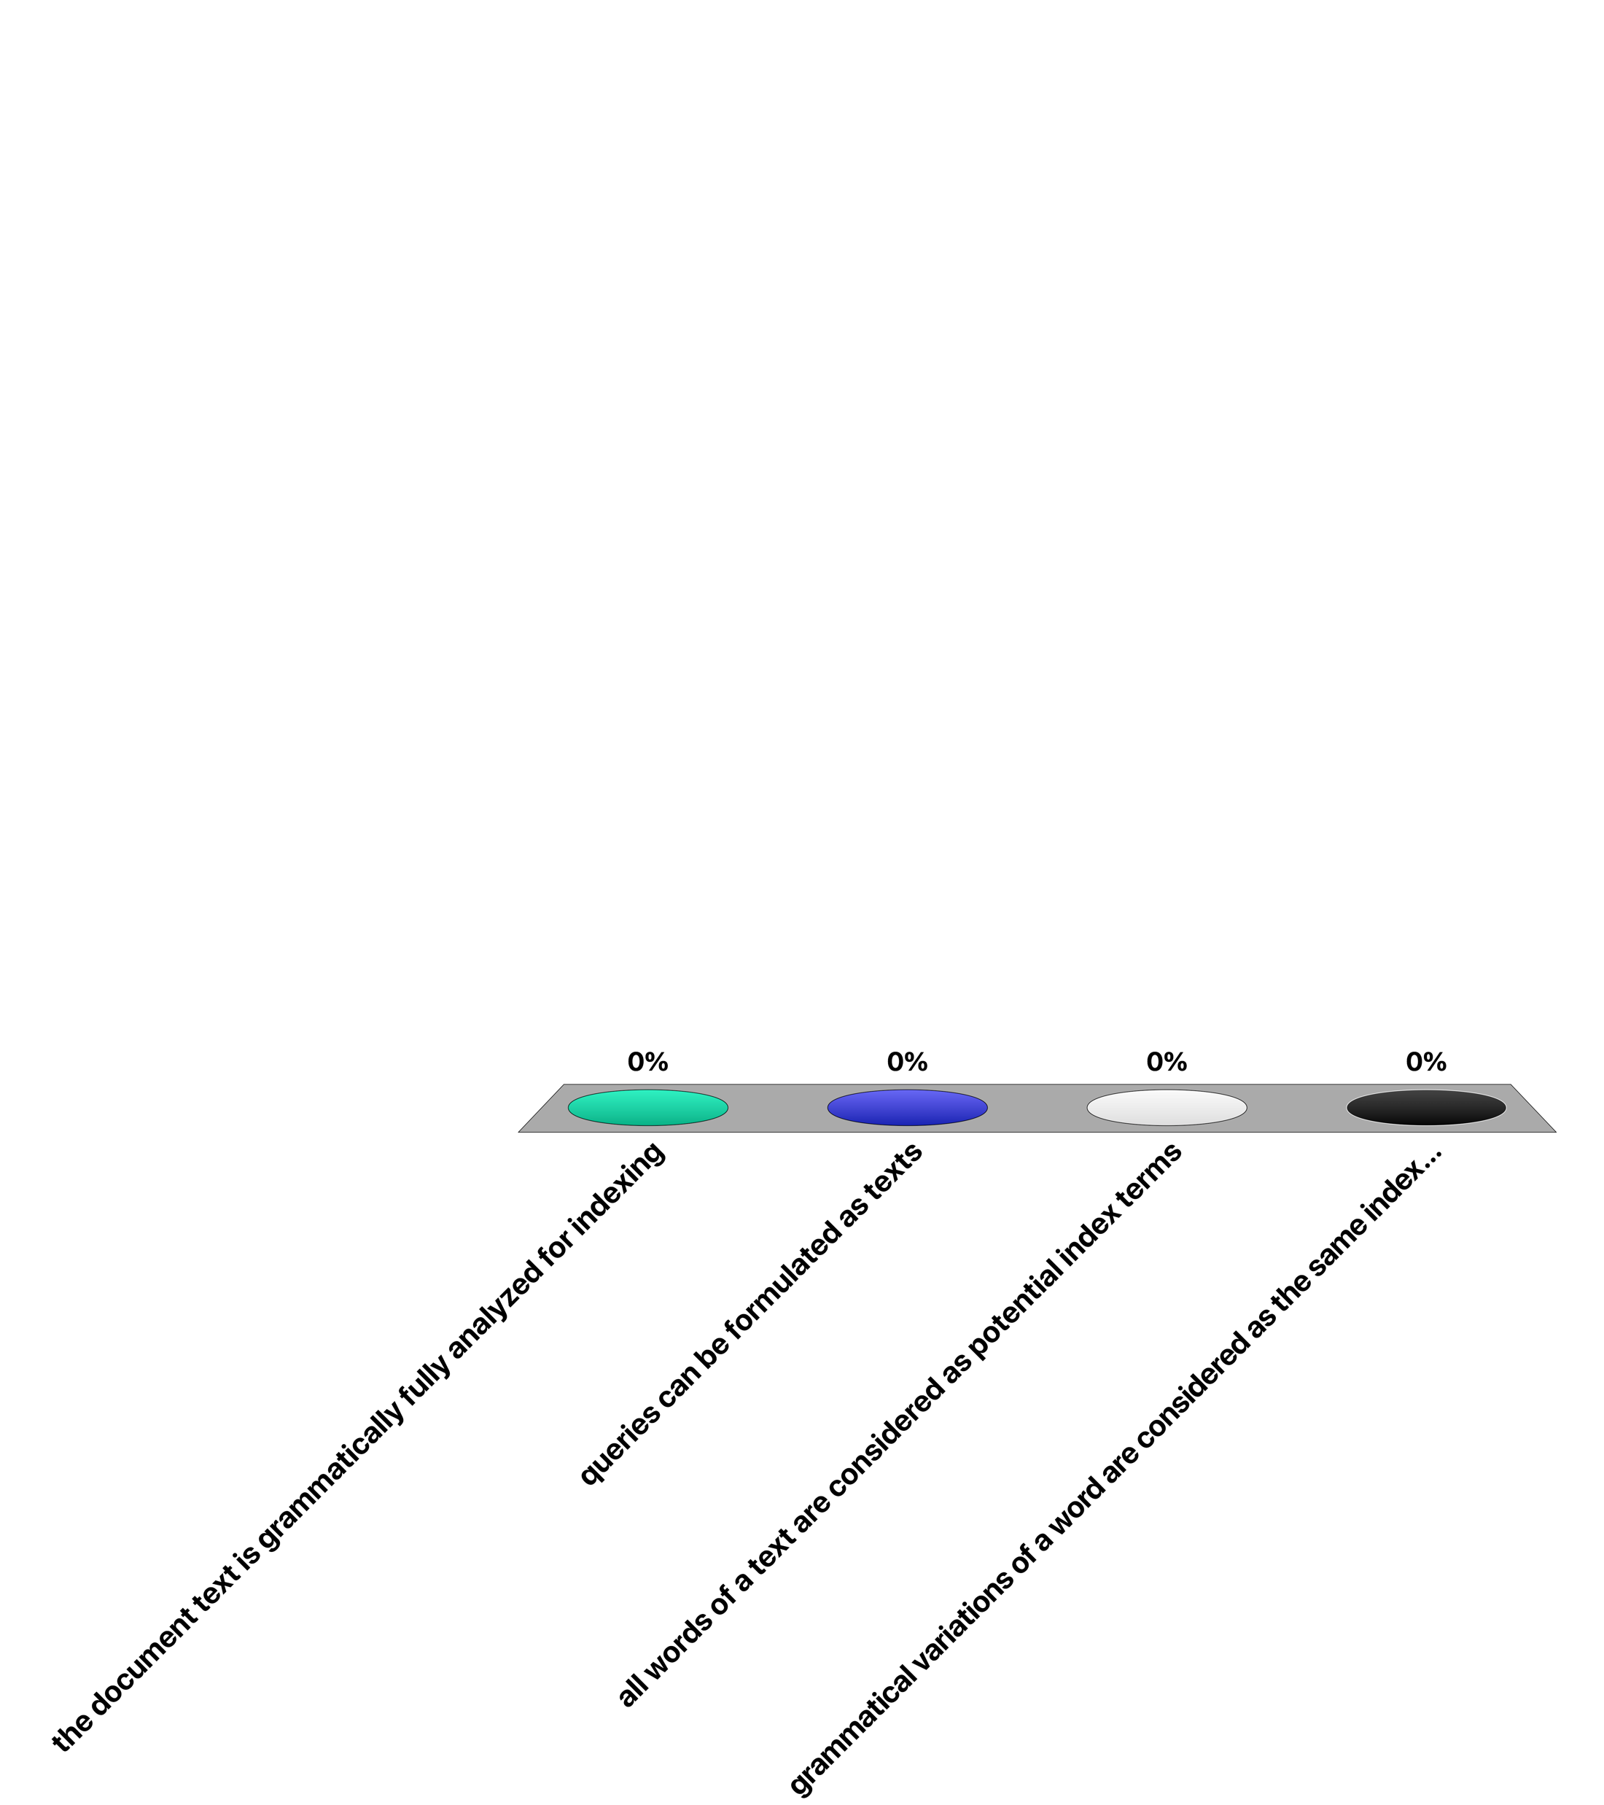
Full-text retrieval refers to the fact that …
the document text is grammatically fully analyzed for indexing
queries can be formulated as texts
all words of a text are considered as potential index terms
grammatical variations of a word are considered as the same index terms

Slide 25
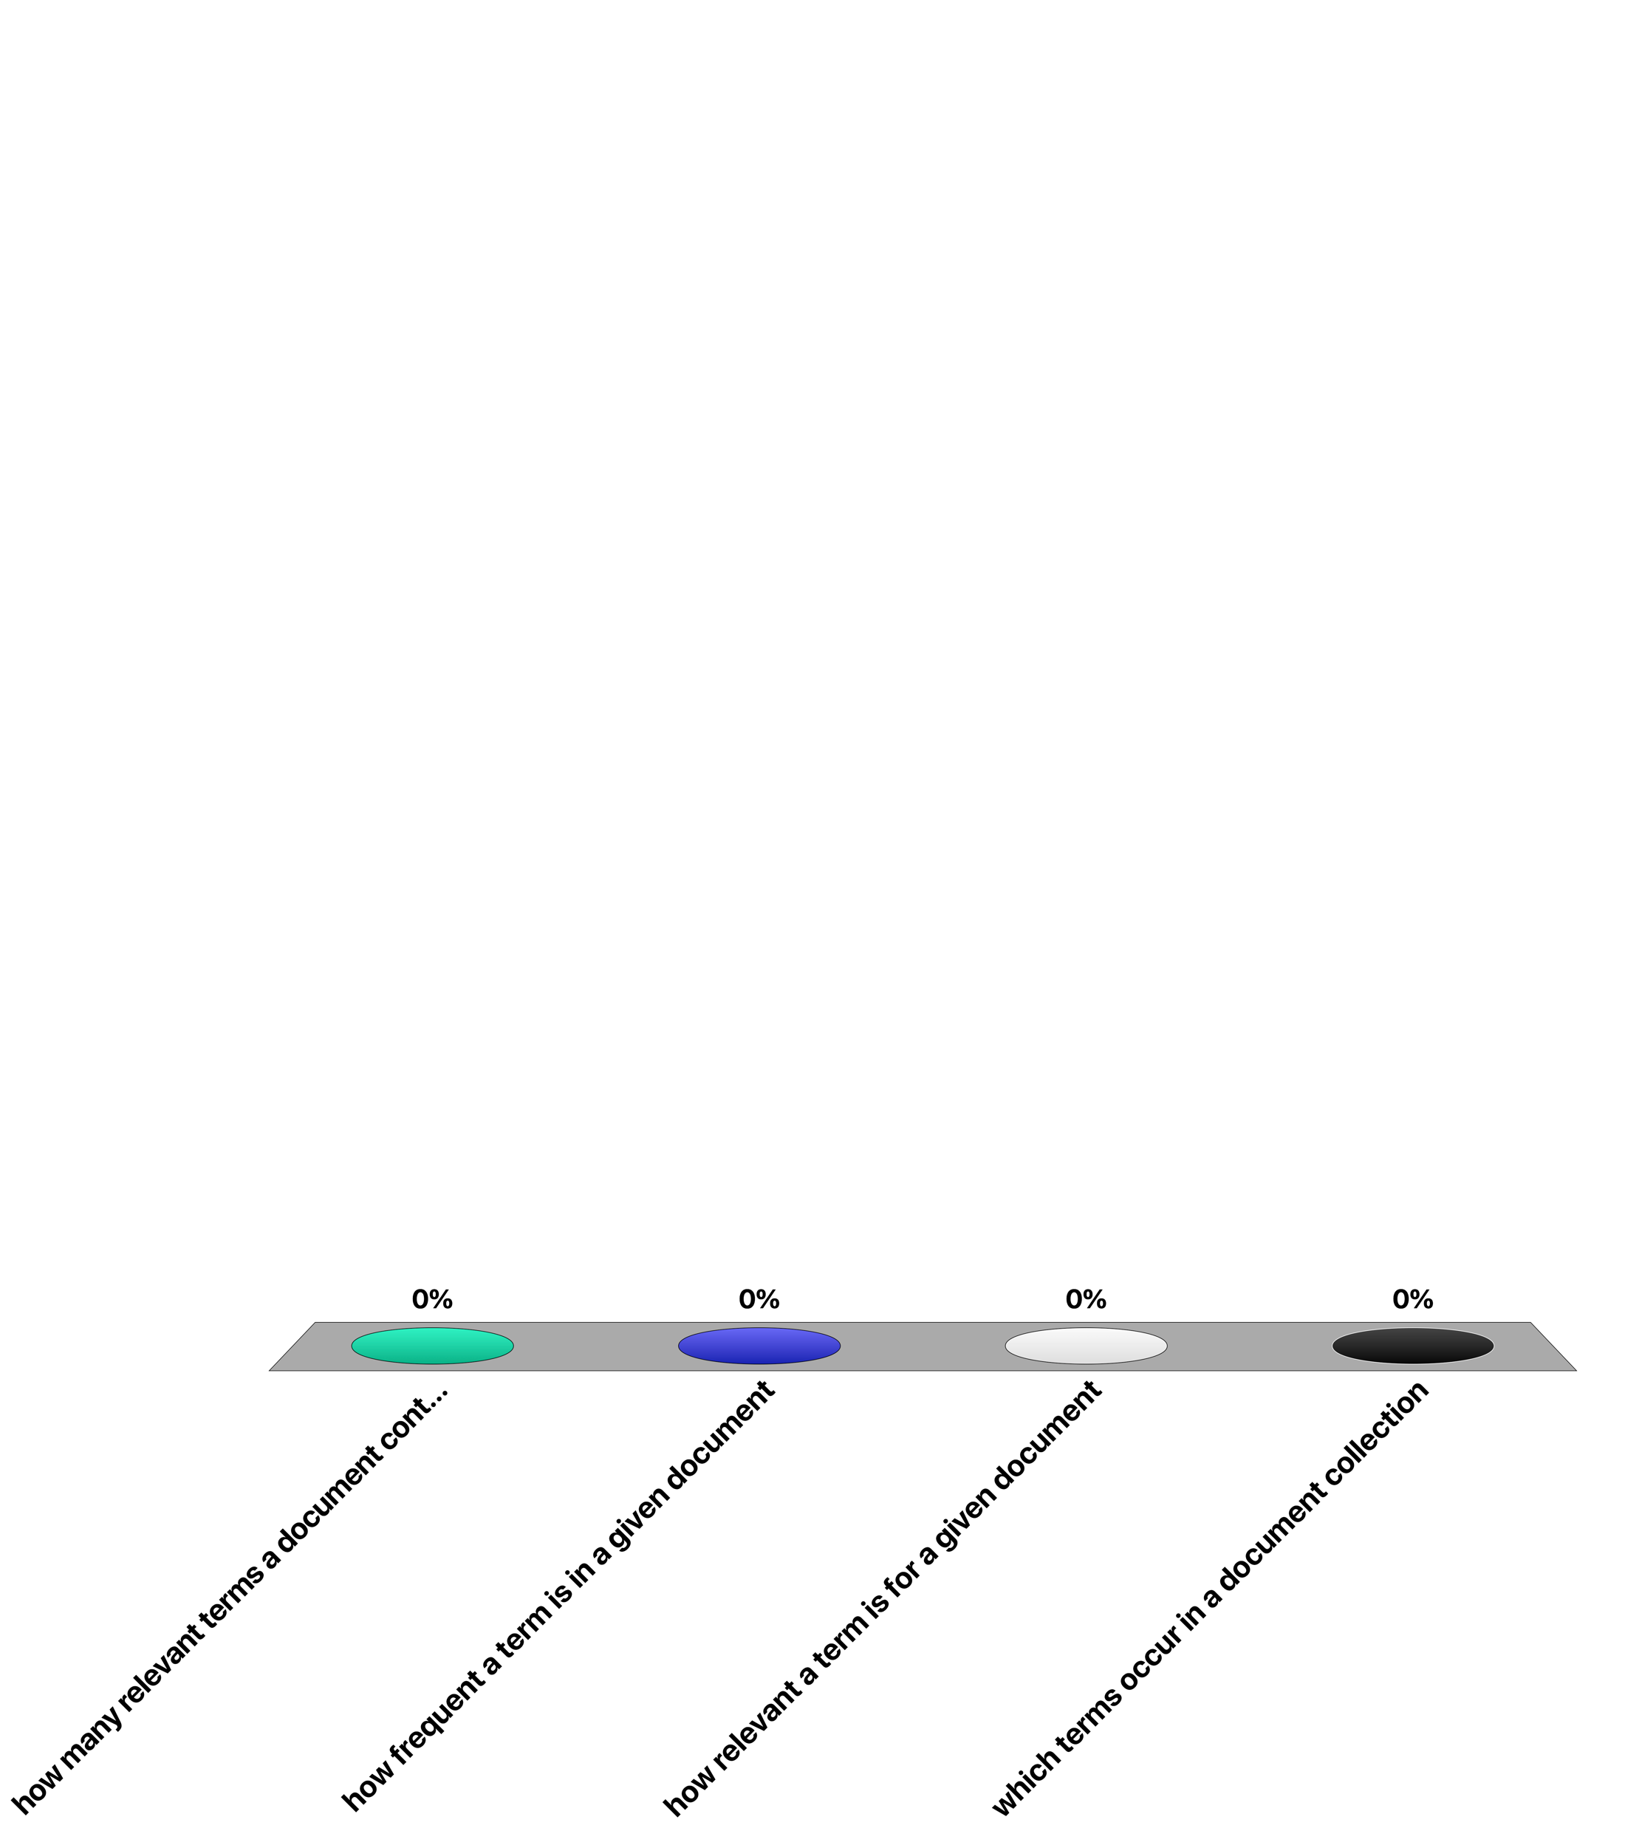
The entries of a term-document matrix indicate …
how many relevant terms a document contains
how frequent a term is in a given document
how relevant a term is for a given document
which terms occur in a document collection

Slide 26
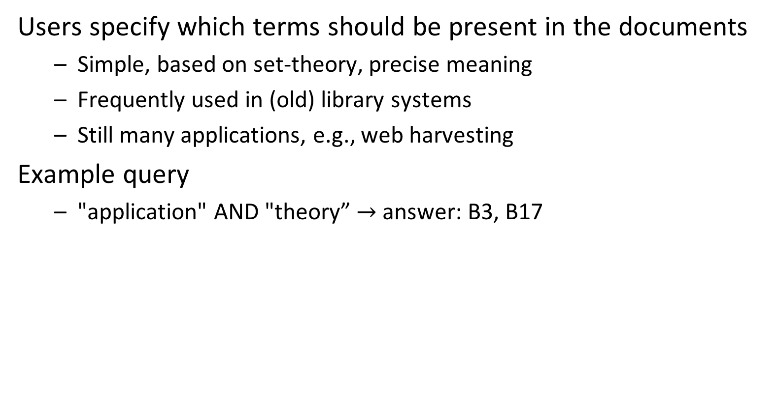
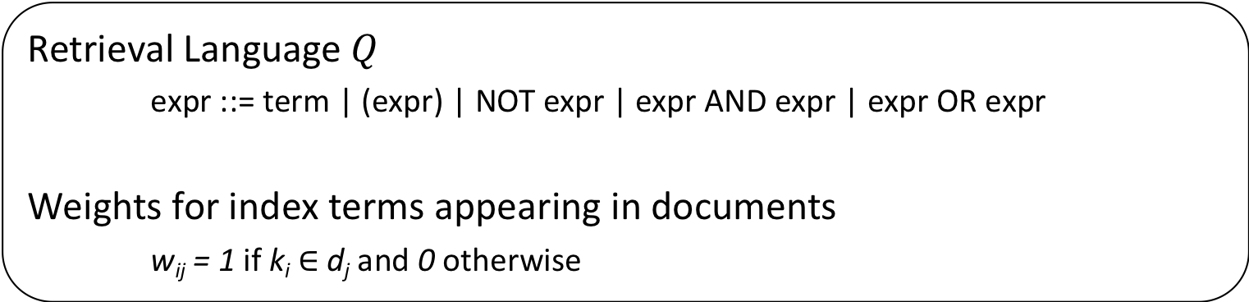
Boolean Retrieval
Users specify which terms should be present in the documents
Simple, based on set-theory, precise meaning
Frequently used in (old) library systems
Still many applications, e.g., web harvesting
Example query
"application" AND "theory” $→$ answer: B3, B17
Retrieval Language $Q$
expr ::= term | (expr) | NOT expr | expr AND expr | expr OR expr
Weights for index terms appearing in documents
w_{ij} = 1 if k_{i} $∈$ d_{j} and 0 otherwise
Notes:
Early information retrieval systems (as well as many search systems in use today, such as spotlight and windows search) use the Boolean retrieval model. This model is actually more similar to database querying, as requests are specified as first order (Boolean) expressions. Term weights are set to 1 when a term occurs in a document, just as in the term-document matrix on the previous slide.

Slide 27
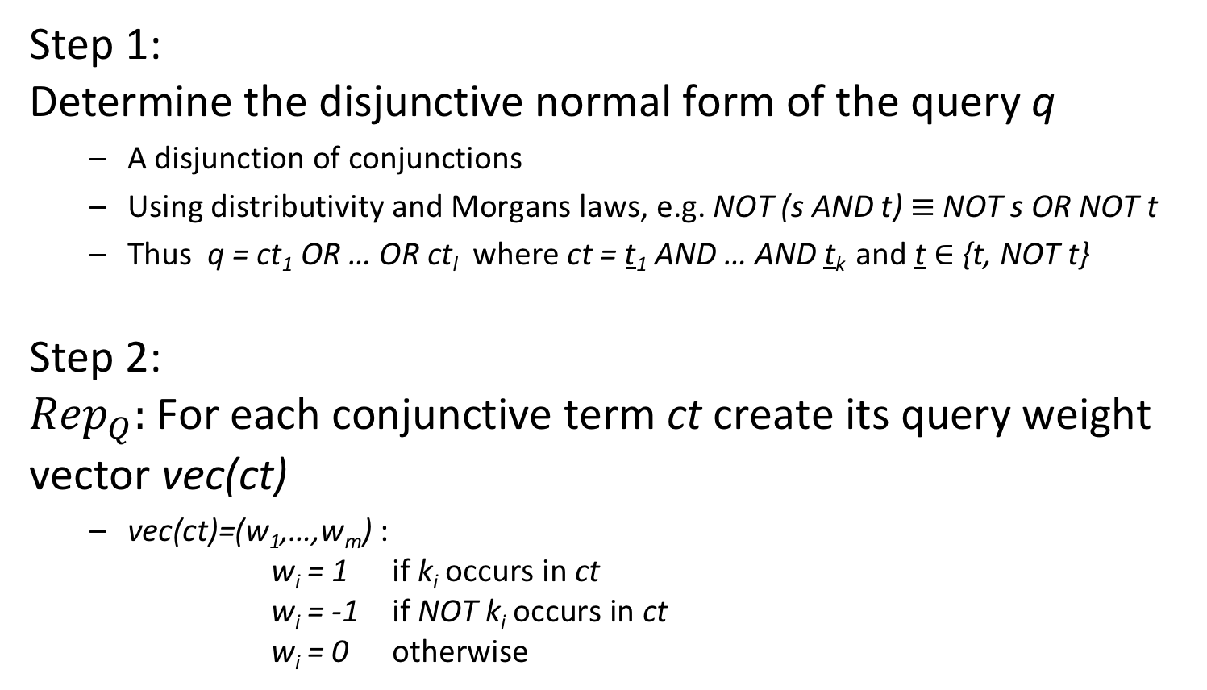
"Similarity" Computation in Boolean Retrieval
Step 1: Determine the disjunctive normal form of the query q
A disjunction of conjunctions
Using distributivity and Morgans laws, e.g. NOT (s AND t) $≡$ NOT s OR NOT t
Thus q = ct₁ OR … OR ct_{l} where ct = t₁ AND … AND t_{k} and t $∈$ {t, NOT t}
Step 2: ${Rep}_{Q}:$For each conjunctive term ct create its query weight vector vec(ct)
vec(ct)=(w₁,…,w_{m}) : w_{i} = 1 if k_{i} occurs in ct w_{i} = -1 if NOT k_{i} occurs in ct w_{i} = 0 otherwise
Notes:
Computing the similarity of a document with a query reduces in Boolean retrieval to the problem of checking whether the term occurrences in the document satisfy the Boolean condition specified by the query. In order to do this in a systematic manner, a Boolean query is first normalized into disjunctive normal form. Using this equivalent representation, checking whether a document matches the query reduces to the problem of checking whether the document vector, i.e., the column of the term-document matrix corresponding to the document, matches one of the conjunctive terms of the query.

Slide 28
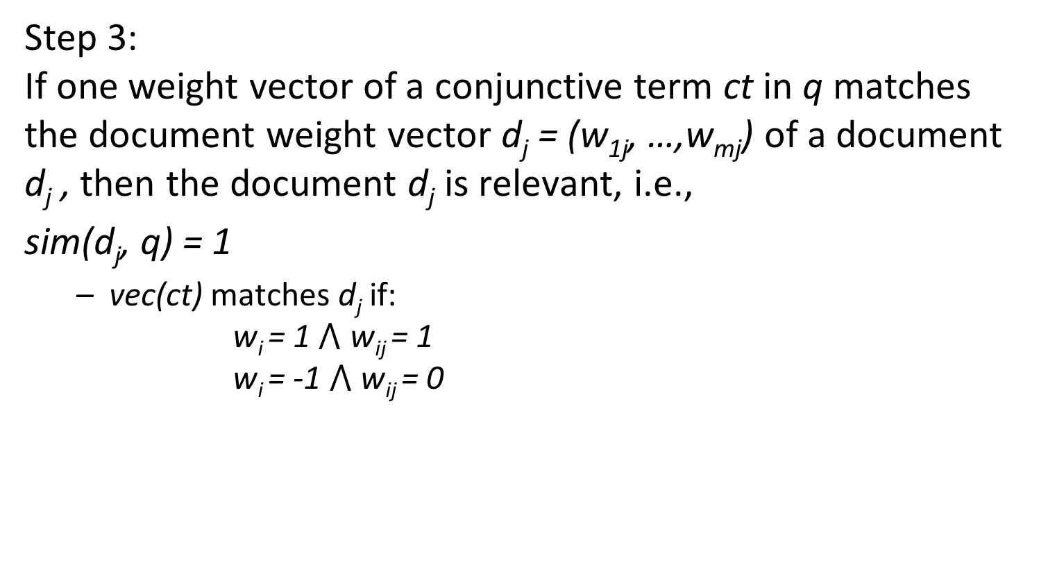
"Similarity" Computation in Boolean Retrieval
Step 3: If one weight vector of a conjunctive term ct in q matches the document weight vector d_{j} = (w_{1j}, …,w_{mj}) of a document d_{j} , then the document d_{j} is relevant, i.e.,
sim(d_{j}, q) = 1
vec(ct) matches d_{j} if: w_{i} = 1 $⋀$ w_{ij} = 1 w_{i} = -1 $⋀$ w_{ij} = 0
Notes:
A match is established if the document vector contains all the terms of the query vector in the correct form, i.e., if the term occurs positively in the query the term has to occur in the document, if the term occurs in the negated form in the query the term must not occur, and if the term does not occur in the query it may or may not occur in the document.

Slide 29
Example
Index terms {application, algorithm, theory}
Query "application" AND ("algorithm" OR NOT "theory")
Disjunctive normal form of query ("application" AND "algorithm" AND "theory") OR
("application" AND "algorithm" AND NOT "theory") OR
("application" AND NOT "algorithm" AND NOT "theory")
Query weight vectors q={(1,1,1), (1,1,-1), (1,-1,-1)}
Documents d₁={algorithm, theory, application} (1,1,1) d₂={algorithm, theory} (0,1,1) d₃={application, algorithm} (1,1,0)
Result sim(d₁, q) = sim(d₃, q) = 1, sim(d₂, q) = 0
Notes:
This example illustrates a complete Boolean retrieval process for our sample document collection.
The transformation from the original query to the disjunctive normal form proceeds in the following steps:
application AND (algorithm OR NOT theory) ->
(application AND algorithm) OR
(application AND NOT theory)->
(application AND algorithm AND (theory OR NOT theory) OR
(application AND (algorithm or NOT algorithm) AND NOT theory) ->
(application AND algorithm AND theory) OR
(application AND algorithm AND NOT theory) OR
(application AND algorithm AND NOT theory) OR
(application AND NOT algorithm AND NOT theory) ->
(application AND algorithm AND theory) OR
(application AND algorithm AND NOT theory) OR
(application AND NOT algorithm AND NOT theory)

Slide 30
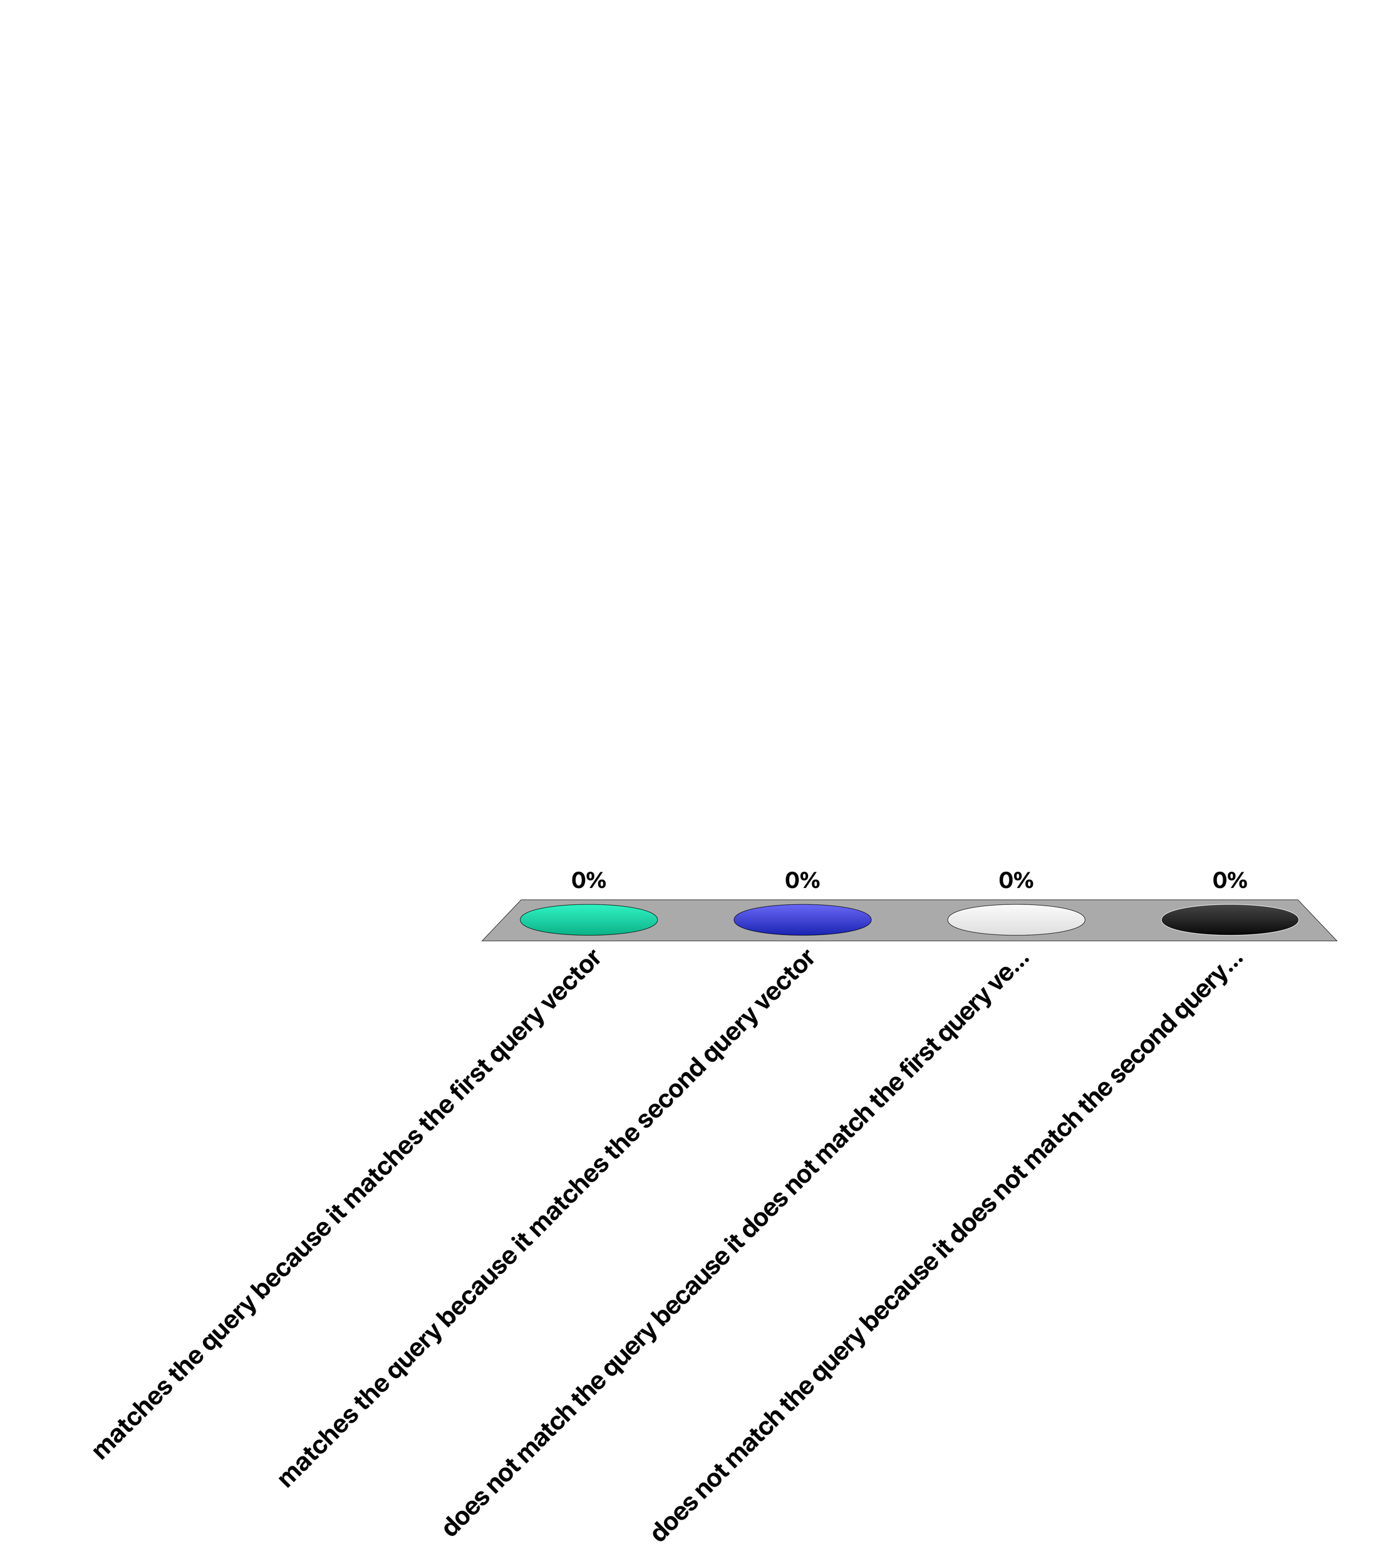
Let the query be represented by {(1, 0, -1), (0, -1, 1)} and the document by (1, 0, 1). The document …
matches the query because it matches the first query vector
matches the query because it matches the second query vector
does not match the query because it does not match the first query vector
does not match the query because it does not match the second query vector

Slide 31
3. Vector Space Retrieval

Slide 32
Vector Space Retrieval
Limitations of Boolean Retrieval
No ranking: problems with handling large result sets
Queries are difficult to formulate
No tolerance for errors
Queries either return far too many results, or none
Key Idea of Vector Space Retrieval
Use “free text” queries
represent both the document and the query by a weight vector in the m-dimensional keyword space assigning non-binary weights
determine their distance in the m-dimensional keyword space
Notes:
The main limitation of the Boolean retrieval model is its incapability to rank the result and to match documents that do not contain all the keywords of the query. More complex requests become very difficult to formulate. Finally it is hard to predict for the user whether a query would produce a reasonably sized set of results. Often either no results are returned, if the query is too restrictive or very large numbers of results are produced in the opposite case.
The vector space retrieval model addresses these issues by supporting non-binary weights, i.e., real numbers in [0,1], both for documents and queries, and producing continuous similarity measures in [0,1]. The similarity measure is derived from the geometrical relationship of vectors in the m-dimensional space of document/query vectors. By using free text queries, i.e. users can formulate any text as query, the vector space model also simplifies the task of query formulation for users.

Slide 33
Similarity Computation in Vector Space Retrieval
k₁
d_{j}
Θ
q
k_{m}
Since w_{ij} > 0 and w_{iq} $≥$ 0, 0 $≤$ sim(q, d_{j}) $≤$ 1
Notes:
The distance measure for vectors has to satisfy the following properties:
If two vectors coincide completely their similarity should be maximal, i.e., equal to 1.
If two vectors have no keywords in common, i.e., if wherever the query vector has positive weights the document vector has weight 0, and vice versa – or in other words if the vectors are orthogonal – the similarity should be minimal, i.e., equal to 0.
in all other cases the similarity should be between 0 and 1.
The scalar product (which is equivalent to the cosine of the angle of two vectors) has exactly these properties and is therefore (normally) used as similarity measure for vector space retrieval.
A good question is why not use Euclidean distance, instead of Cosine distance. The problem with Euclidean distance is that different documents with the same or similar distribution of term weights, but of different vector length would give very different results, whereas their meaning would be the same or similar. E.g. the documents with vectors (1,1,0) and (2,2,0) would probably carry the same meaning. But their distances to a query vector would be very different.

Slide 34
Vector Space Retrieval - Properties
Properties
Ranking of documents according to similarity value
Documents can be retrieved even if they don’t contain some query keyword
Today’s standard text retrieval technique
Web Search Engines
The vector model is the basis of most search engines, however they do not rely on it exclusively
It is simple and fast to compute
Notes:
The vector space retrieval model is the standard retrieval technique used both on the Web and for classical text retrieval.

Slide 35
Example
query vector: "application algorithms" (1,1)
document vector:
"algorithms" (0, 1) (B5, B7)
document vector: "application algorithms" (1,1) (B3)
Issue: how to determine
the weights for q and d_{j}?
document vector: "application" (1, 0) (B17)
Notes:
We apply the same weighting scheme for the document and query vectors as in the case of Boolean retrieval, and show the results vector space retrieval produces. We observe that also documents containing only one of the two keywords occurring in the query, would show up in the result, although with lower similarity value.
Since in vector space retrieval no longer exclusively binary weights are used, a central question is of how to determine weights that more precisely determine the importance of a term for the document. Obviously not all terms carry the same amount of information on the meaning of a document. This was for example one of the reasons to eliminate stop words, as they normally carry no meaning at all.

Slide 36
Term Frequency
Documents are similar if they contain the same keywords (frequently)
Therefore use the frequency freq(i,j) of the keyword k_{i} in the document d_{j} to determine the weight of the document vectors
(Normalized) term frequency of term k_{i} in Document d_{j}
Notes:
An obvious difference that can be made among terms is with respect to their frequency of occurrence in a document. Thus a weighting scheme for documents can be defined by considering the (relative) frequency of terms within a document. The term frequency is normalized with respect to the maximal frequency of all terms occurring within the document.

Slide 37
Example
Vocabulary T = {information, retrieval, agency}
Query q = (information, retrieval) = (1,1,0)
information … …retrieval …
…information…
…retrieval …
retrieval … …retrieval …
…retrieval …
…retrieval …
"Result"
D1 = (1, 1, 0)
sim(q,D1)=1
D2 = (0,1,0)
sim(q,D2)=0.7071…
agency … …information…
retrieval…
…agency …
retrieval … …agency …
…retrieval…
…agency…
D3 = (0.5,0.5, 1)
sim(q,D3)=0.5773…
D4 = (0, 1, 1)
sim(q,D4)=0.5
Notes:
This example illustrates the use of term frequency. Assume we form the query vector by simply setting the weight to 1 if the keyword appears in the query. Then we would obtain D1 and D2 as result. Actually, this result appears to be non-intuitive, since we would expect that D3 is much more similar to q than D2. What has gone wrong?
The problem is that the term "retrieval", since it occurs very frequently in D2, leads to a high similarity value for D2. On the other hand the term retrieval has very little power to disambiguate meaning in this document collection, since every document contains this term. From an information-theoretic perspective one can state, that the term "retrieval" does not reduce the uncertainty about the result at all.

Slide 38
Inverse Document Frequency
We have not only to consider how frequent a term occurs within a document (measure for similarity), but also how frequent a term is in the document collection of size n (measure for distinctiveness)
Inverse document frequency can be interpreted as the amount of information associated with the term k_{i}
Inverse document frequency of term k_{i}
n_{i} number of documents in which term k_{i} occurs
Term weight (tf-idf) w_{ij} = tf(i,j) idf(i)
Notes:
Thus we have to take into account not only the frequency of a term within a document, when determining the importance of the term for characterizing the document, but also the discriminative power of the term with respect to the document collection as a whole. For that purpose, the inverse document frequency is computed and included into the term weight.
We can see now from this weighting scheme that eliminating stop words is actually an optimization of computing similarity measures in vector space retrieval. Since stop words normally occur in every document of a collection, their term weights will normally be 0 and thus the terms do not play a role in retrieval. Thus it is of advantage to exclude them already from the retrieval process at the very beginning.

Slide 39
Example
Vocabulary T = {information, retrieval, agency}
Query q = (information, retrieval) = (1,1,0)
idf(information)=idf(agency)=log(2)
idf(retrieval)=log(1)=0
information … …retrieval …
…information…
…retrieval …
retrieval … …retrieval …
…retrieval …
…retrieval …
D1 = (log(2), 0, 0)
sim(q,D1)=0.7071…
D2 = (0,0,0)
sim(q,D2)=0
"Result"
agency … …information…
retrieval…
…agency …
retrieval … …agency …
…retrieval…
…agency…
D3 = (0.5 log(2),0, log(2))
sim(q,D3)=0.316…
D4 = (0,0, log(2))
sim(q,D4)=0
Notes:
We have now: n=4, n_{information}=2, n_{retrieval}=4, n_{agency}=2
The result corresponds much better to the "expectation" when using the inverse document frequencies.

Slide 40
Query Weights
The same considerations as for document term weights apply also to query term weights
Example: Query q = (information, retrieval)
Query vector: (log(2), 0, 0)
Scores: sim(q, D1)= 0.569… sim(q, D2)=0 sim(q, D3)=0.254 sim(q, D4)=0
Query weight for query q
Notes:
Finally, we have to look at the question of how to determine the weights for the query vector. One can apply the same principles as for determining the document vector, as is shown. In practice there exist a number of variations of this approach.

Slide 41
Example
Query q = "application theory"
Boolean retrieval result
application AND theory: B3, B17
application OR theory: B3, B11, B12, B17
Vector retrieval result
Query vector (0, 2.14…, 0, 0, 0, 0, 0, 0, 0, 0, 0, 0, 0, 0, 0, 1.447…)
Ranked Result: B17 0.770078… B3 0.684042… B12 0.232951… B11 0.232951…
Notes:
This examples provides an illustration of the differences of Boolean and vector space retrieval.

Slide 42
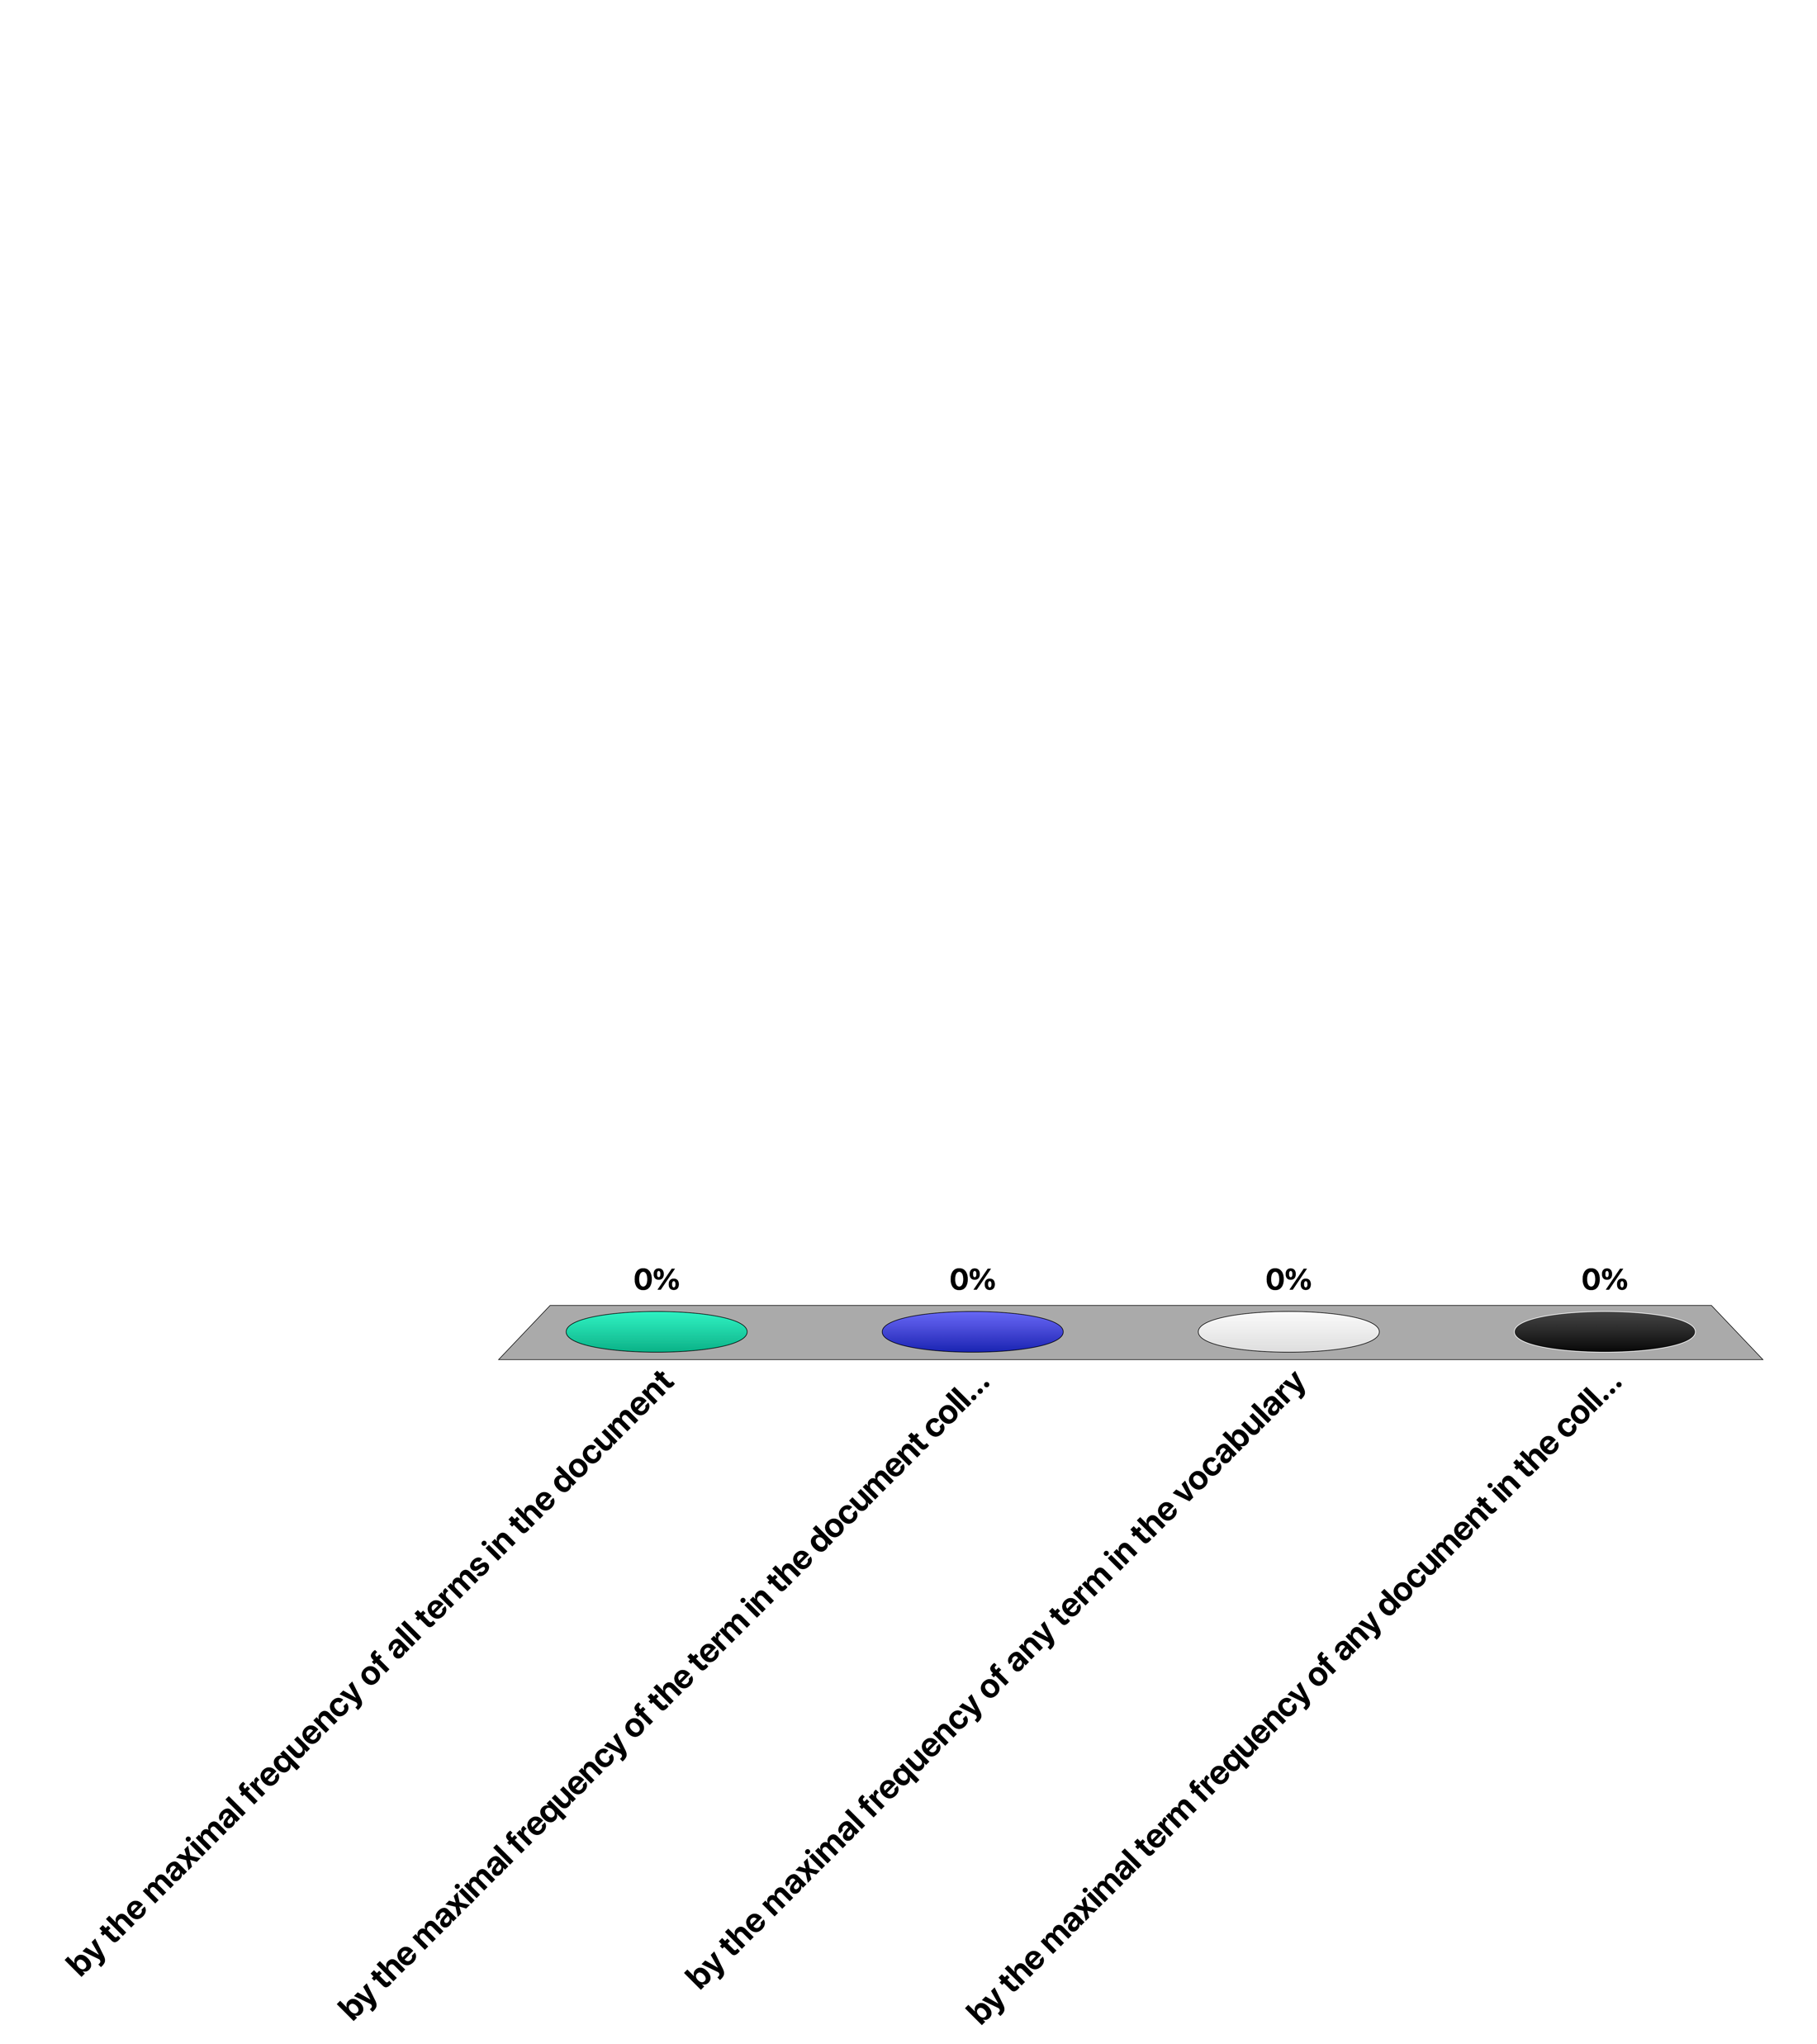
The term frequency of a term is normalized …
by the maximal frequency of all terms in the document
by the maximal frequency of the term in the document collection
by the maximal frequency of any term in the vocabulary
by the maximal term frequency of any document in the collection

Slide 43
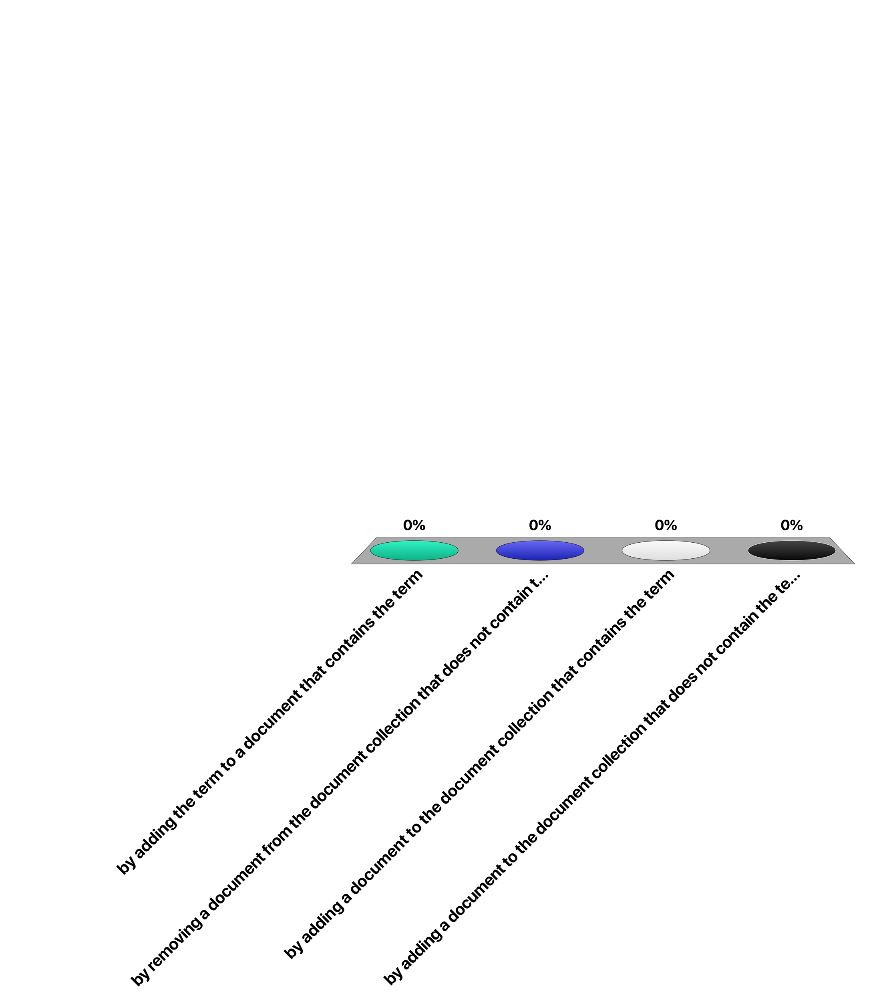
The inverse document frequency of a term can increase …
by adding the term to a document that contains the term
by removing a document from the document collection that does not contain the term
by adding a document to the document collection that contains the term
by adding a document to the document collection that does not contain the term

Slide 44
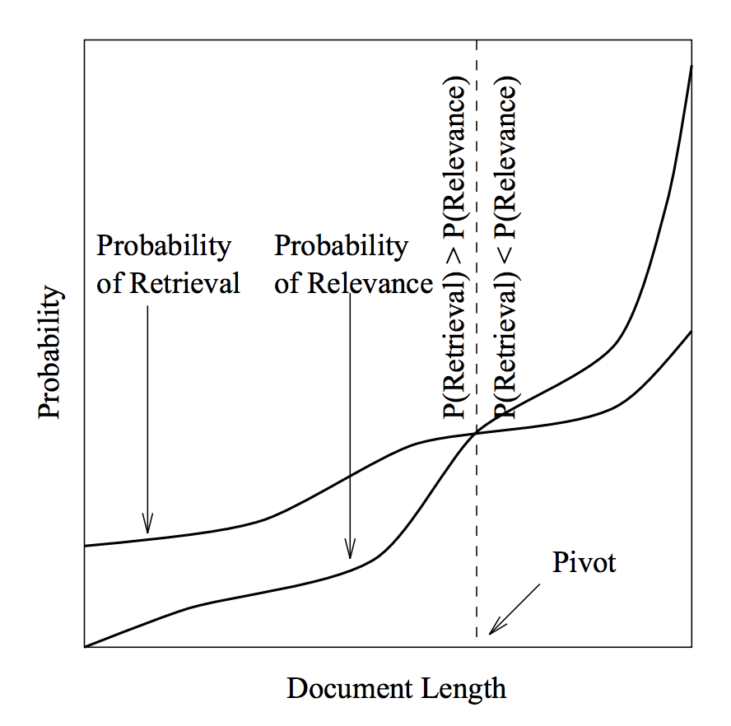
The Role of Document Length
When computing cosine similarity, document vectors are normalized
Result: for Query “information”: doc2 will be favored because it is shorter
information agency retrieval system
doc1
(0.25,0.25,0.25,0.25)
information
agency
doc2
Singhal 1996
(0.5,0.5,0,0)
Notes:
For a long term the suspicion was that the standard vector space retrieval method favors short documents over long documents as a result of the normalization of document vectors. While normalizing document vectors a term that occurs in the query would receive a lower weight in the longer document , as it has to share the total weigth of 1 with a larger number of terms, and thus the longer document is less likely to receive a high rank. In a seminal paper Singhal and co-authors provided empirical evidence for this phenomenon. The compared for a TREC dataset the likelihood of a document of a given length of being relevant (by relying on the manual evaluation) with the propobability that a document of that length would be retrieved using standard vector retrieval. The graph shows clearly that shorter documents have better chances to show up in the result, than longer ones, even when they are less relevant. The pivot point is the document length where the both probabilities match.

Slide 45
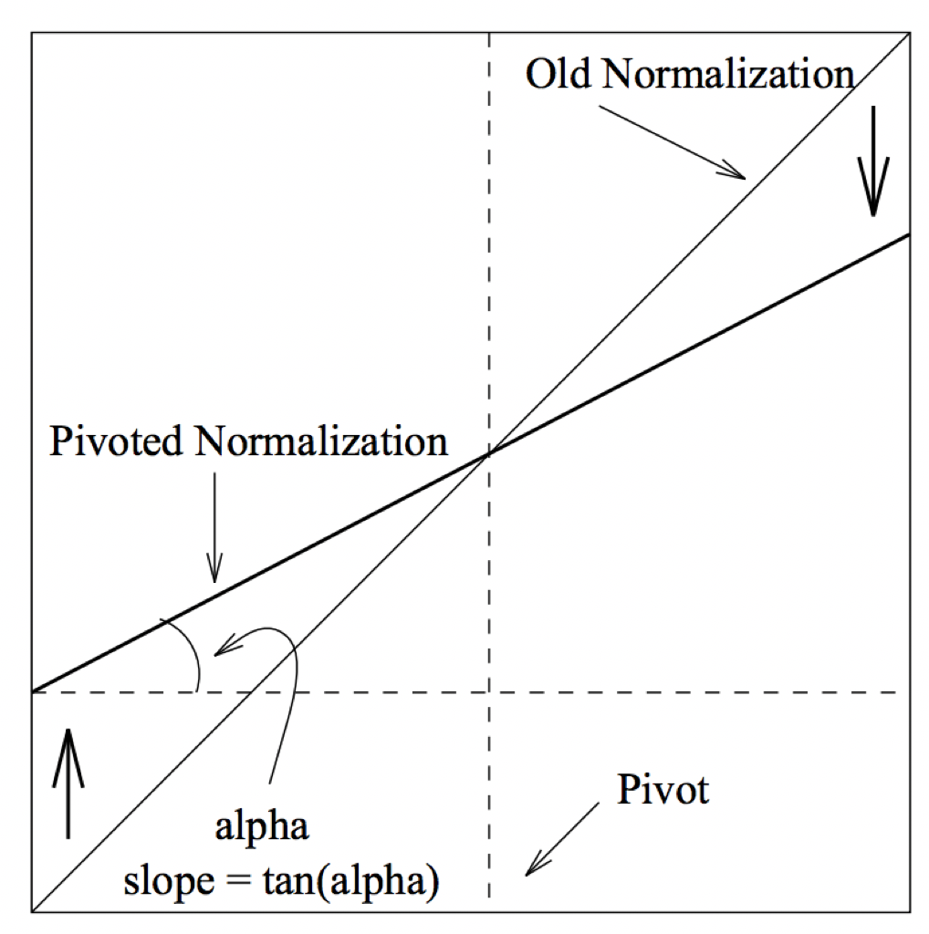
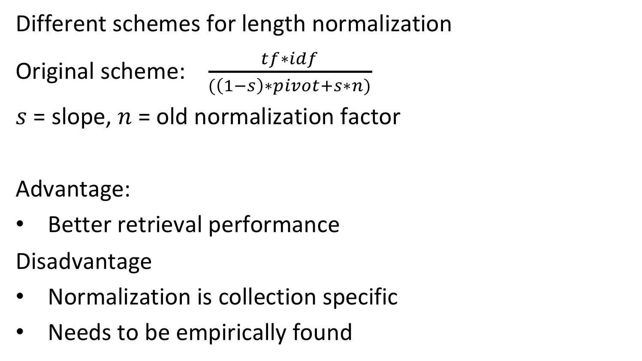
Length Normalization
Different schemes for length normalization
Original scheme: $\frac{tf∗idf}{(\left(1−s\right)∗pivot+s∗n)}$
$s$ = slope, $n$ = old normalization factor
Advantage:
Better retrieval performance
Disadvantage
Normalization is collection specific
Needs to be empirically found
Cosine normalization factor
Notes:
To correct for this phenomenon different normalization schemes accounting for document length have been proposed, such as the original one from Singhal. As this normalization schemes contain a parameter, like the slope parameter in Singhal schemes, this parameter needs to be chosen. The choice depends on the document collection and can be based on empirical evaluations.
The figure illustrates how the slope is found. A pivot point $pivot$ and slope $s$ are chosen (empirically). Then the orginal normalization factor $n$ (used to normalize the tf-idf vector), is modified by computing a new normalization factor.

Slide 46
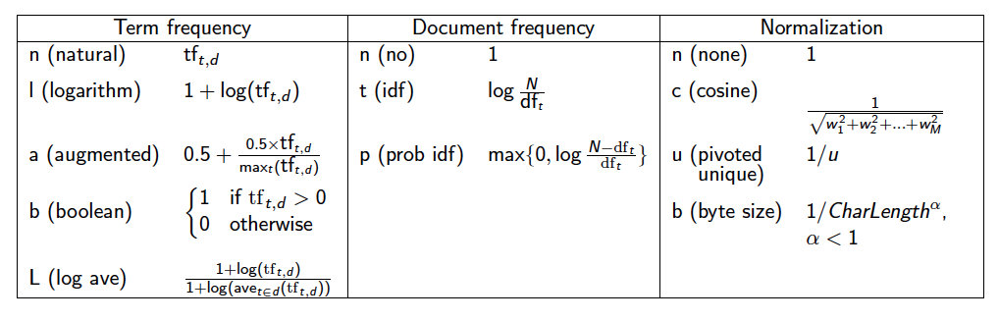
Variants of Vector Space Retrieval Model
The vector model with tf-idf weights is a good ranking strategy for general collections
many alternative weighting schemes exist, but are not fundamentally different
Notes:
Different variants of tf-idf weighting schemes have been developed and used over time. They can be combined with each other, also independently for the weighting of document and query terms. One important variant is the logarithmic weighting of term frequencies, which moderates the influence of very frequently occurring terms in documents.

Slide 47
Discussion of Vector Space Retrieval Model
Advantages
term-weighting improves quality of the answer set
partial matching allows retrieval of docs that approximate the query conditions
cosine ranking formula sorts documents according to degree of similarity to the query
Disadvantages
assumes independence of index terms; not clear that this is a disadvantage
No theoretical justification why the model works
Notes:
We summarize here the main advantages of the vector space retrieval model. It has proven to be a very successful model for general text collections, i.e., if there exists no additional (context) information on the documents that could be exploited, e.g., from a specific application domain. Providing a ranked result improves the usability of the approach, as users can more easily distinguish more relevant documents from less relevant documents. The model inherently assumes that there exist no mutual dependencies in the occurrences of the terms, i.e., that certain terms appear together more frequently than others. Studies have however shown that taking such co-occurrence probabilities additionally into account, can actually HURT the performance of the retrieval system. The reason is that co-occurrence probabilities are often related to specific application domains and thus do not easily transfer to general-purpose retrieval.
One of the principal criticisms of the vector space model is the lack of theoretical explanation why it works. At the end, it is a heuristics. This drawback has been addressed with other models, in particular probabilistic retrieval models.

Slide 48
4. Evaluating Information retrieval

Slide 49
Evaluating a Retrieval Model
Quality of a retrieval model depends on how well it matches user needs!
Comparison to database querying
correct evaluation can be formally verified
Notes:
The quality of a retrieval system can principally only be determined through the degree of satisfaction of its users. This is fundamentally different to database querying, where there exist criteria for correct query answering that can be formally verified, e.g., whether a result set retrieved from a database matches the logical conditions specified in a query.

Slide 50
Evaluating Information Retrieval
Test collections with test queries, where the relevant documents are identified manually are used to determine the quality of an IR system (e.g. TREC)
Document collection
True negatives
False negatives
Relevant documents R
True positives
Answer set A
False positives
Notes:
Since there exists no objective criterion whether an information retrieval query is correctly answered, other means for evaluating the quality of an information retrieval system are required. The approach is to compare the performance of a specific system to human performance in retrieval. For that purpose test collections of documents, such as TREC (http://trec.nist.gov/), are created and for selected queries human experts select the relevant documents. Note that this approach assumes that humans have an agreed-upon, objective notion of relevance, an assumption that can be easily challenged of course.

Slide 51
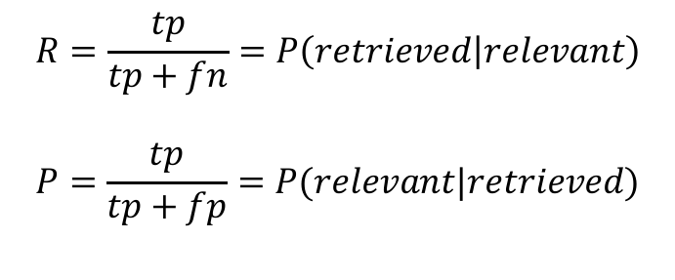
Recall and Precision
Recall is the fraction of relevant documents retrieved from the set of total relevant documents collection-wide
Precision is the fraction of relevant documents retrieved from the total number retrieved (answer set)
 | Relevant | Non-relevant
Retrieved | True positives (tp) | False positives (fp)
Not Retrieved | False negatives (fn) | True negatives (tn)
$$R=\frac{tp}{tp+fn}=P\left(retrieved | relevant\right)$$
$$P=\frac{tp}{tp+fp}=P(relevant|retrieved)$$
Notes:
The results of IR systems are compared to the expected result in two ways:
Recall measures how large a fraction of the expected results is actually found.
Precision measures how many of the results returned are actually relevant.
Important note: This measure evaluates an unranked result set. All elements of the result are considered as equally important.

Slide 52
Recall and Precision – A Tradeoff
Suppose you search for “Theory of Relativity”.
Optimizing recall: retrieve all pages mentioning “theory” and “relativ*”
We will have probably most documents talking about the topic
We might have results such as, “In theory, I feel relatively good”, “Relative to the theory of evolution …” etc.
Optimizing precision: retrieve all pages mentioning “relativity theory” and “expanding universe”
Most likely all results are relevant
But we might miss “the theory of relativity by Einstein”
Thus high recall hurts precision and vice versa
Notes:
This example expands upon the point that we made in the previous slide. Simply recalling all web pages that match the search query does not ensure precision—in other words relevance to user needs is not a simple matter.

Slide 53
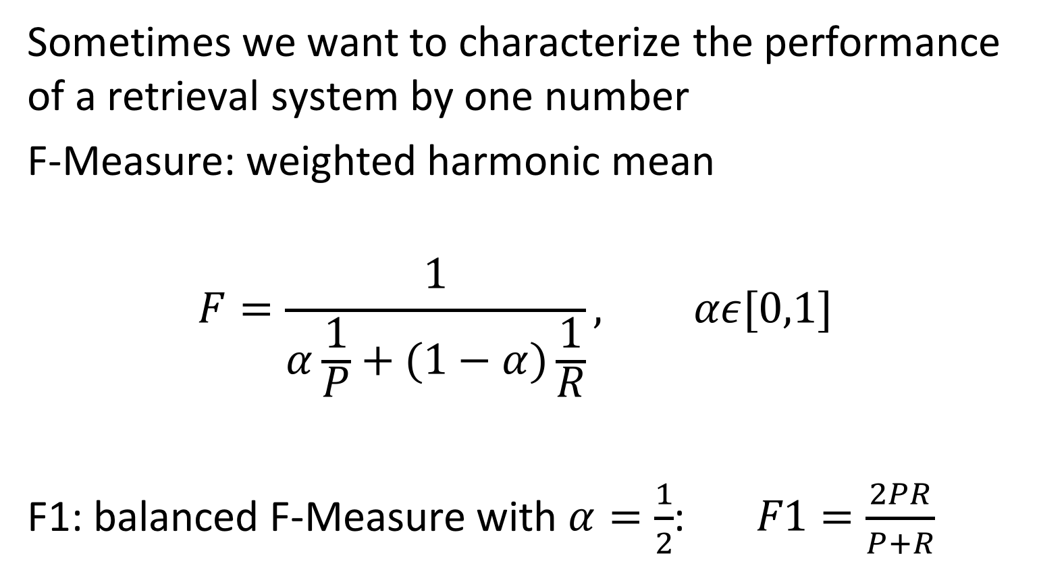
Combined Measures
Sometimes we want to characterize the performance of a retrieval system by one number
F-Measure: weighted harmonic mean
$$F=\frac{1}{α\frac{1}{P}+(1−α)\frac{1}{R}}, αε[0,1]$$
F1: balanced F-Measure with $α=\frac{1}{2}$: $F1=\frac{2PR}{P+R}$
Notes:
Sometimes one wants to characterize the performance of a retrieval system by a single measures. Different types of means could be considered, e.g., the arithmetic mean or the accuracy measure, i.e. (tp + tn) / (tp + tn + fp + fn). Accuracy, which is used in evaluating quality of classifiers could be considered, as retrieval can be understood as the problem of classifying into two sets, relevant and non-relevant. However, since the set of relevant documents is usually much smaller than the set of non-relevant documents, the measure could be optimized by declaring all documents non-relevant. Arithmetic mean is also no suitable, since when choosing 100% recall we would always have at least 50% of arithmetic mean between recall and precision. Therefore in practice the harmonic mean is used. It can be tuned by the parameter alpha. Larger values of alpha emphasize the importance of precision and smaller ones the importance of recall
F1 is when alpha = 1/2

Slide 54
Precision/Recall Tradeoff in Ranked Retrieval
An IR system ranks documents by a similarity coefficient, allowing the user to trade off between precision and recall by choosing the cutoff level
Precision depends on the number of results retrieved: P@k = precision for the top-k documents
hypothetical ideal IR system
realistic IR systems
Notes:
One of the two measures of recall and precision can always be optimized. Recall can be optimized by simply returning the whole document collection, whereas precision can be optimized by returning only very few results. Important is the trade-off: the higher the precision for a specific recall, the better the information retrieval system. A hypothetical, optimal information retrieval system would return results with 100% percent precision always. If a system ranks the results according to relevance the user can control the relation between recall and precision by selecting a threshold of how many results he/she inspects.
At the beginning the precision in high because only relevant documents are retrieved. The more the number of retrieved doc incresed the higher the recall will be.

Slide 55
Evaluating Ranked Retrieval
Recall-Precision Plot
R N R N R R N N R R R N R N R R (10 relevant documents)
Notes:
If we draw the Recall-Precision graph for a ranked retrieval result, we will find the following picture. The precision will always drop when non-relevant documents are returned and increase when relevant documents are returned. The green dots correspond to relevant documents and the red dots to non-relevant ones.
The ratio is: I cannot be worst in the future

Slide 56
Interpolated Precision
Interpolated precision: $P_{int}(R)=\max_{R′≥R}{P(R^{′})}$
Notes:
In order to convert the recall-precision plot into a monotonically decreasing function, interpolated precision is introduced, which returns always the highest level of precision achieved up to a given recall level.

Slide 57
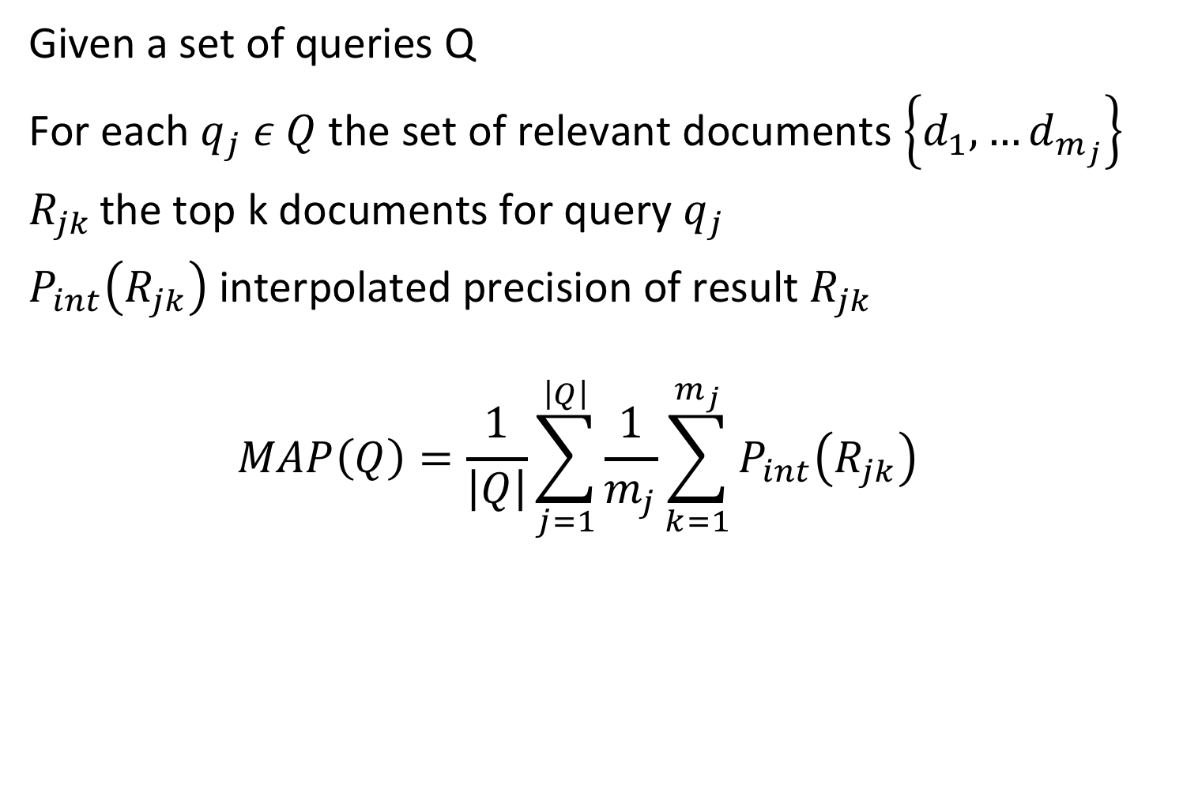
Mean Average Precision (MAP)
Given a set of queries Q
For each $q_{j} ε Q$the set of relevant documents $\left\{d_{1}, …d_{m_{j}}\right\}$
$R_{jk }$the top k documents for query $q_{j}$
$P_{int}\left(R_{jk}\right)$ interpolated precision of result $R_{jk }$
$$MAP\left(Q\right)=\frac{1}{\left|Q\right|}\sum_{j=1}^{\left|Q\right|}{\frac{1}{m_{j}}}\sum_{k=1}^{m_{j}}{P_{int}\left(R_{jk}\right)}$$
Notes:
Mean Average Precision has been shown to be a robust measure for evaluating the quality of a ranked retrieval system for a query collection Q. When a relevant document is not retrieved at all, the precision value in the MAP is 0.
To evaluate an information retrivial system a single query is not enough. To asses the quality of the IR system we need a set of Q.

Slide 58
Example
Assume 4 results are returned for a query q:
R N R N
P@1 = 1, P@2 = 0.5, P@3 = 2/3, P@4 = 0.5
P_{int}@1 = 1, P_{int} @2 = 2/3, P_{int} @3 = 2/3, P_{int} @4 = 0.5
Then MAP({q}) = 1/2 (1 + 2/3) = 5/6
(note : only precision values when retrieving a relevant document are considered)
Notes:
A simple example where the query set Q to be evaluated consists of a single query q. For multiple queries the results would be averaged.

Slide 59
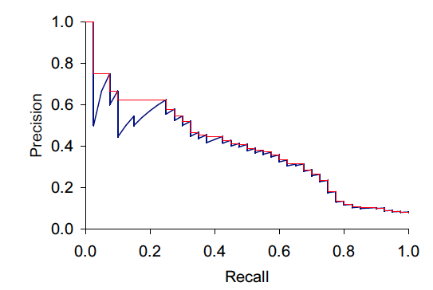
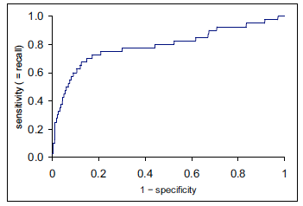
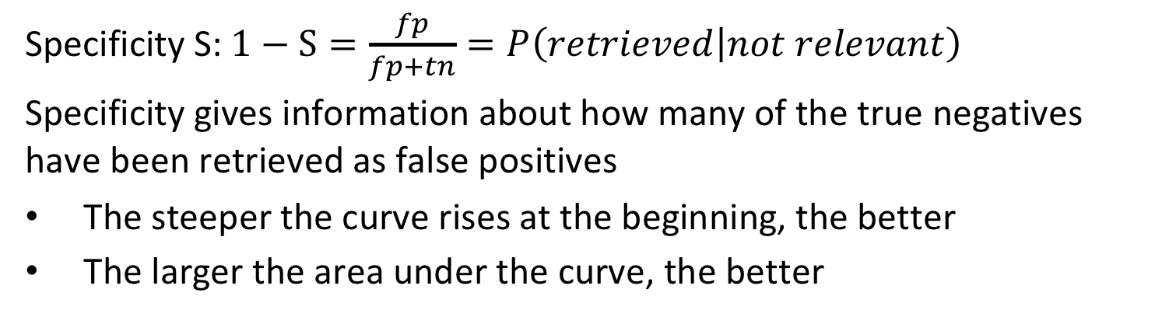
ROC Curve
Specificity S: $1−S=\frac{fp}{fp+tn}=P\left(retrieved | not relevant\right)$
Specificity gives information about how many of the true negatives have been retrieved as false positives
The steeper the curve rises at the beginning, the better
The larger the area under the curve, the better
Notes:
Another frequently used approach to globally evaluate ranked retrieval is the ROC curve. The ROC curve is frequently loosely called a recall-precision curve, which is not accurate (as the figure shows).
The ROC curve relates specificity (on the x-axis) to recall (on the y-axis). Specificity measures the fraction of true negatives that are detected in proportion to all negatives. Thus 1 – specificity is the rate of false positives that have been retrieved, the so-called false positive rate (FPR). In other words, it is the fraction of non-relevant documents among all non-relevant documents that occur in the result. The desired behavior of an IR system is that the curve raises quickly at the beginning, which means that many relevant results are retrieved without having a high fraction of non-relevant documents. This is also equivalent to saying that the area under the curve should be large. Therefore, the area under the ROC curve is sometimes considered similarly as an evaluation of the overall retrieval quality of a retrieval system, analogous to the MAP measure.
Example:
When the recall is at 0.5 then 1-S is at 0.1. This implies that S is 0.9. Then we can conclude that fp = 1/9 tn, or in other words when retrieving half of the relevant documents, then we have also retrieved about 10% of the non-relevant documents.

Slide 60
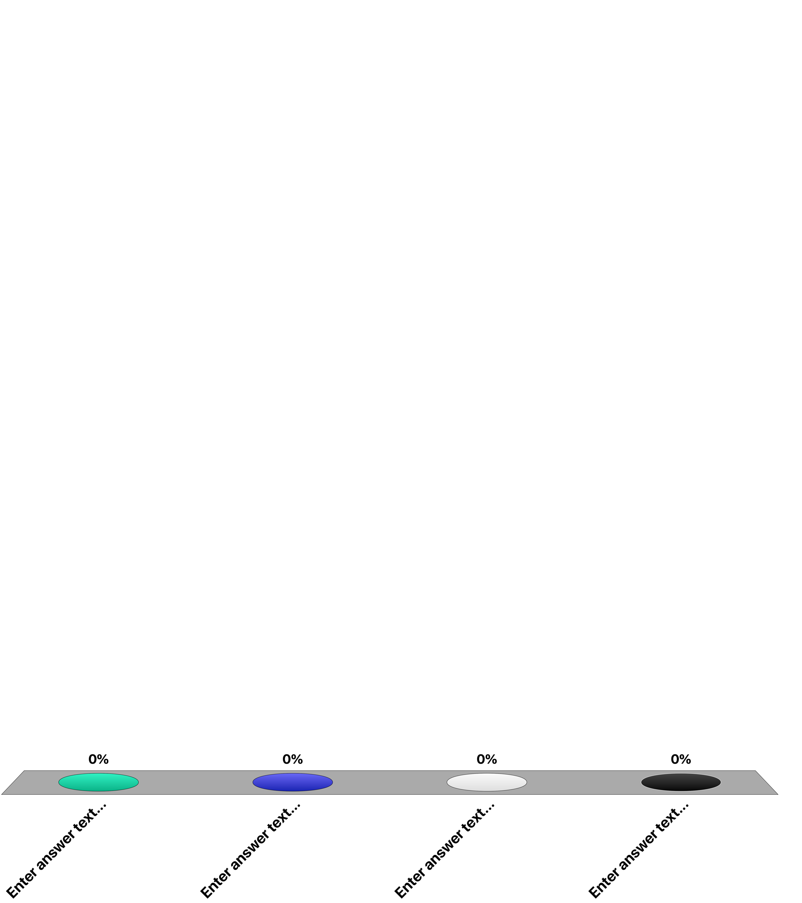
If the top 100 documents contain 50 relevant documents …
the precision of the system at 50 is 0.25
the precision of the system at 100 is 0.5
the recall of the system is 0.5
All of the above
Notes:
2

Slide 61
If retrieval system A has a higher precision at k than system B …
the top k documents of A will have higher similarity values than the top k documents of B
the top k documents of A will contain more relevant documents than the top k documents of B
A will recall more documents above a given similarity threshold than B
the top k relevant documents in A will have higher similarity values than in B

Slide 62
References
Course material based on
Ricardo Baeza-Yates, Berthier Ribeiro-Neto, Modern Information Retrieval (ACM Press Series), Addison Wesley, 1999.
Christopher D. Manning, Prabhakar Raghavan and Hinrich Schütze, Introduction to Information Retrieval, Cambridge University Press. 2008 (http://www-nlp.stanford.edu/IR-book/)
Course Information Retrieval by TU Munich (http://www.cis.lmu.de/~hs/teach/14s/ir/)
Singhal, A., Salton, G., Mitra, M., & Buckley, C. (1996). Document length normalization. Information Processing & Management, 32(5), 619-633.

